Slide 1
Automated ICD Testing Tool
Marco Beccani, Kuk Jang, Houssam Abbas, Zhihao Jiang, and Rahul Mangharam
Department of Electrical and Systems Engineering
University of Pennsylvania
Jackson Liang, MD and Sanjay Dixit, MD
Hospital of the University of Pennsylvania

Slide 2
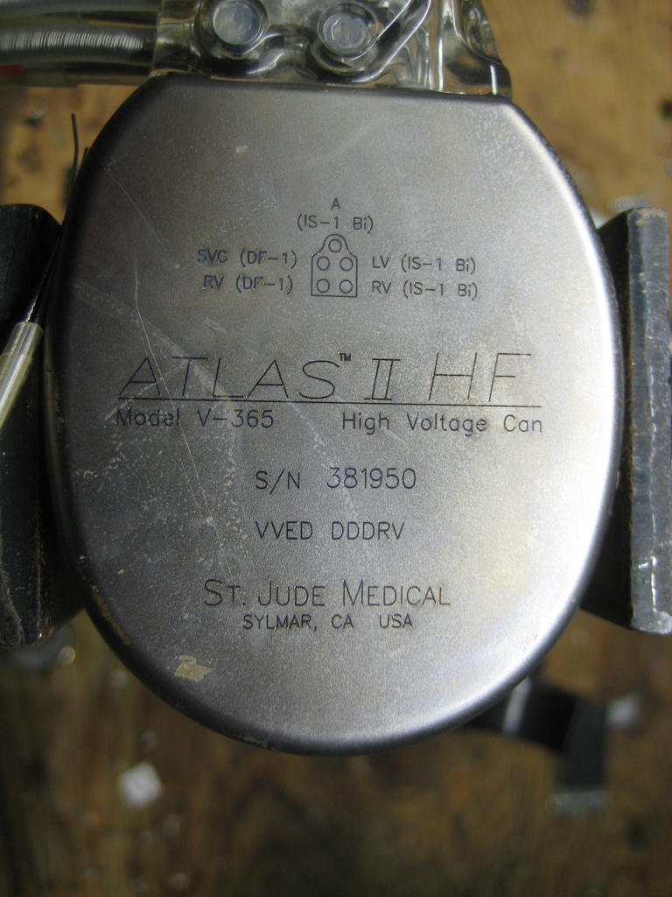
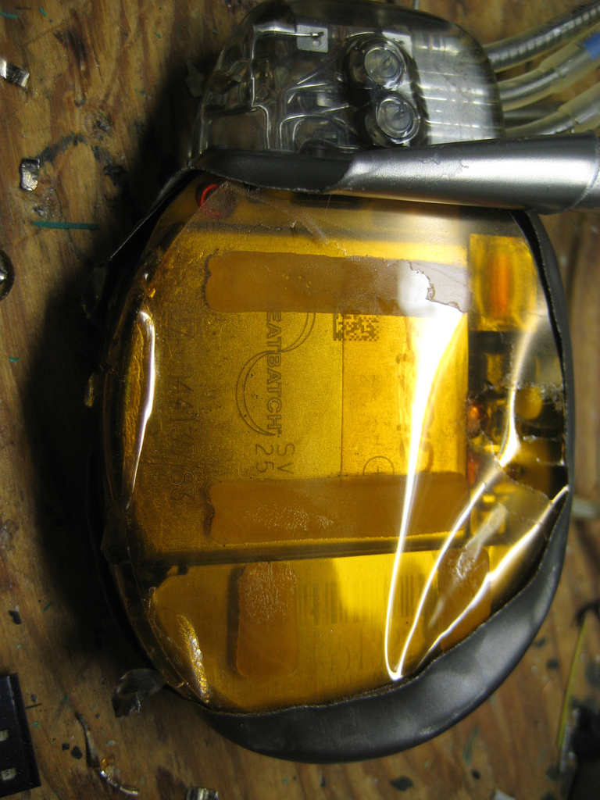
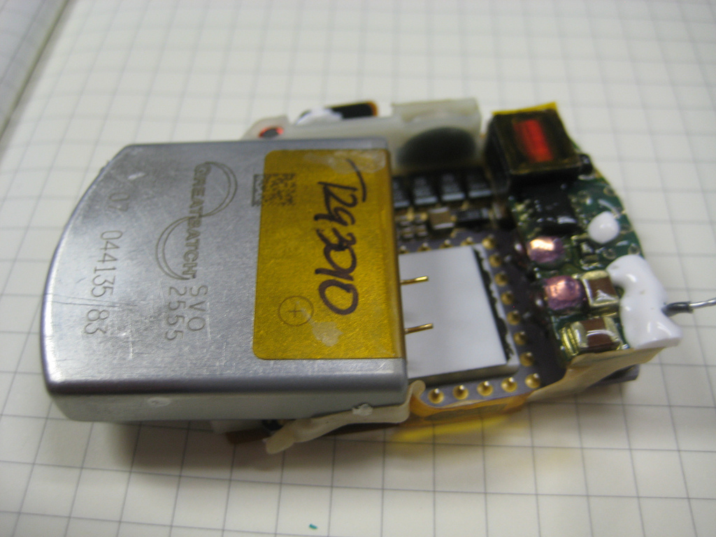
ICD Teardown

Slide 3
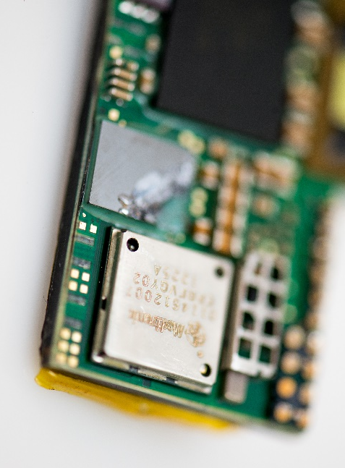
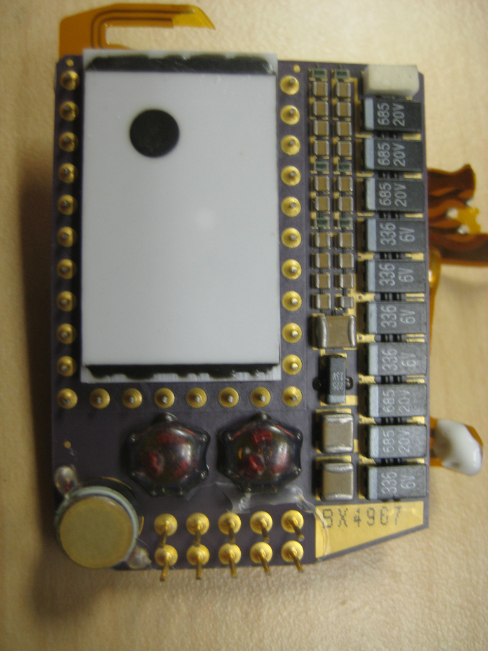
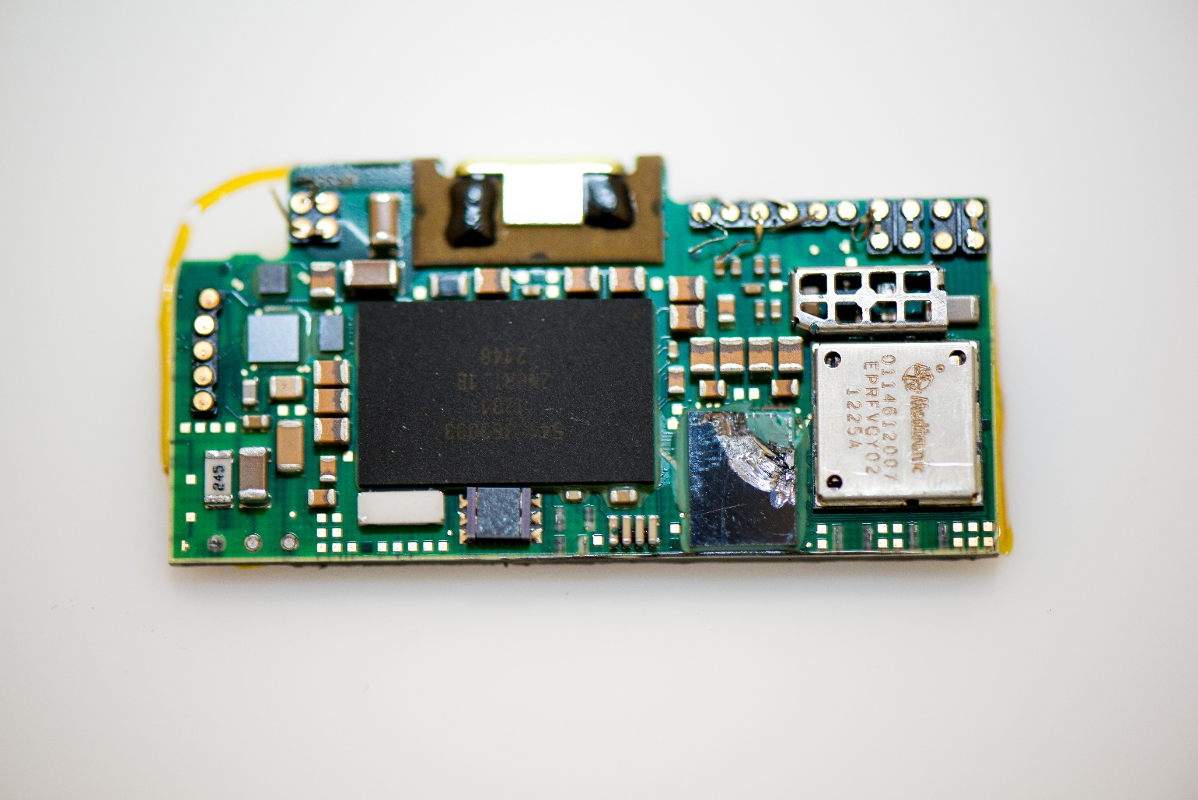
ICD Teardown
Telemetry
Memory
ASIC
DC-DC
converter
Beeper

Slide 4
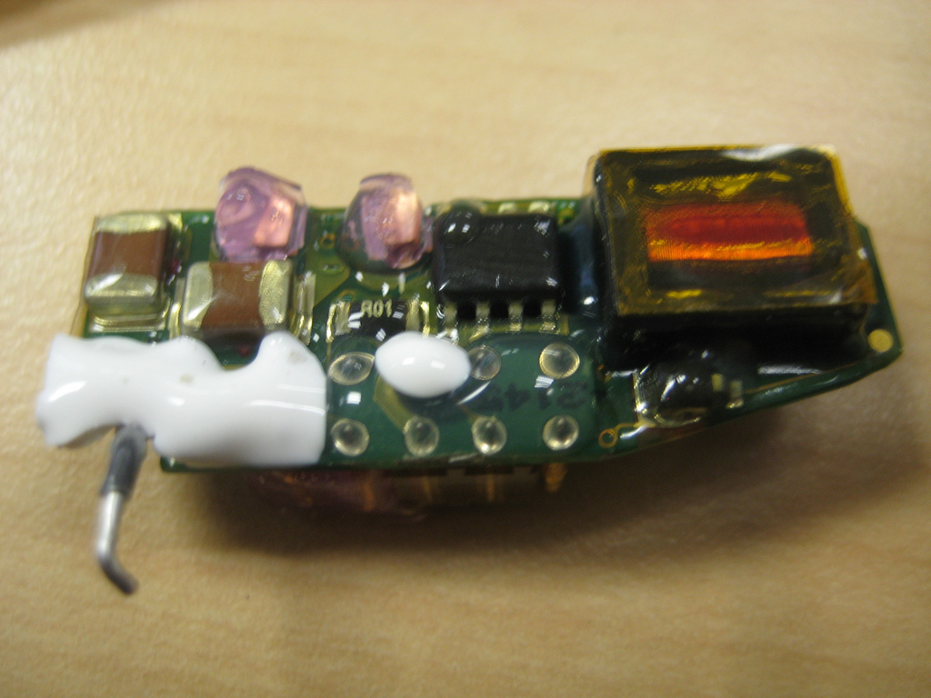
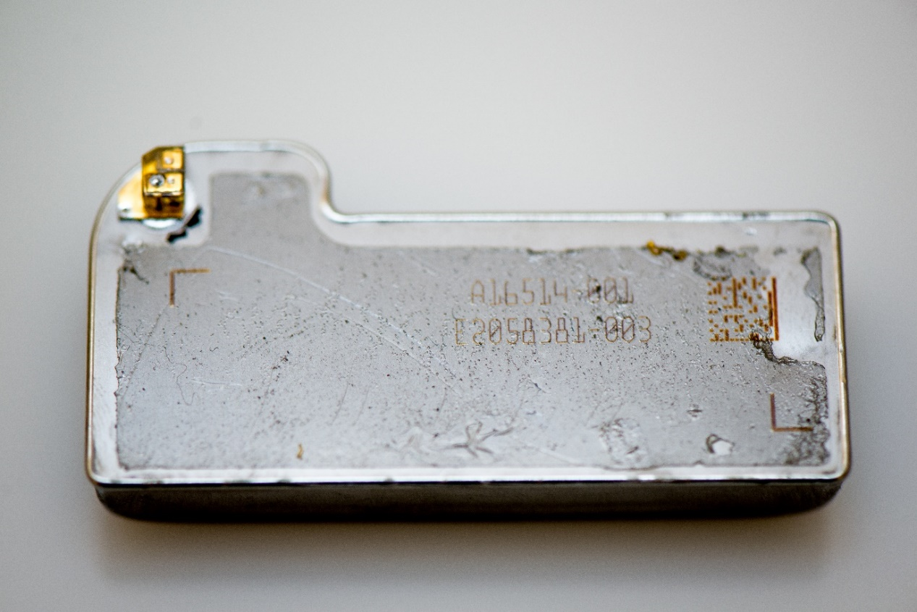
ICD Teardown
Power Module
RF Antenna
Capacitor
Notes:
And these are the components

Slide 5
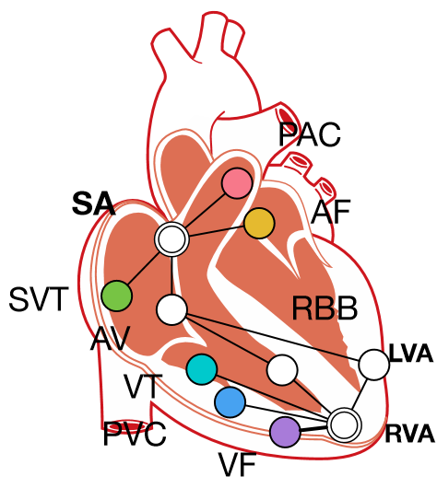
ICD Functional Block diagram
DF +
(Anode)
High Voltage Output Switches
(Analog and Digital)
Sense Amplifier
Pacing Circuitry
Adaptive Sensors
Custom ASIC
High Voltage Output Switches
DF -
(Cathode)
ring
Pace Output Circuit (Pulse Generator)
Charging Circuitry
Heart Model
tip
Filter and High Voltage Protection Circuit
Beeper
Low Power Microprocessor
Telemetry
RAM and ROM

Slide 6
ICD Hardware components
CONNECTOR BLOCK
Suture Anchor
Antenna
Leads
CPU/ASIC
Microprocessor
RF Link
System Management
BATTERY
5-8 y monitoring 0.63 Ah
5-8 y pacing 0.5 Ah
200 Shocks 0.37 Ah
TOTAL 1.5 Ah
CAPACITOR
C = 80-200 µF
V = 700 – 1k V
Energy 25-40 J
Notes:
Talk about the components in details here is summarized
…
Now one of the main problem of ICDs is the fact that they deliver inappropriate shocks…. (click)

Slide 7
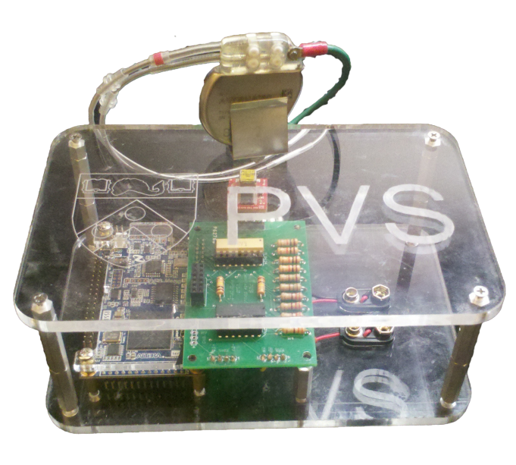
Device Validation
Device in the loop testing
Open ICD Platform
Notes:
In the next slides I will describe how our toolchain can be used to test a real ICD device as well our implementation of it, the Open ICD.

Slide 8
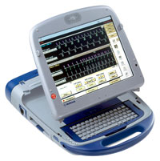
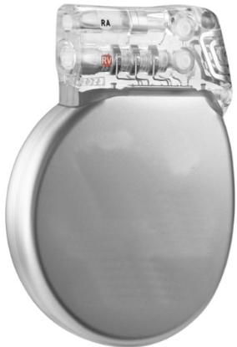
Device in the loop testing
Scenario 1
Commercial ICD
Device Programmer
Scenario 2
Conformance Testing
Scenario 3
Open ICD
Heart Model
Algorithms implemented: Sensing, Detection, Therapy
Notes:
with our hearth model we can generate scenarios to fed the ICD leads. This can be either a commercial device or our implementation of an ICD (OPEN ICD).
If the device delivers a therapy the toolchain can detect it. In this way we can compare the scenario fed to the commercial device and the open ICD and understand if a therapy decision is matching for both the devices.

Slide 9
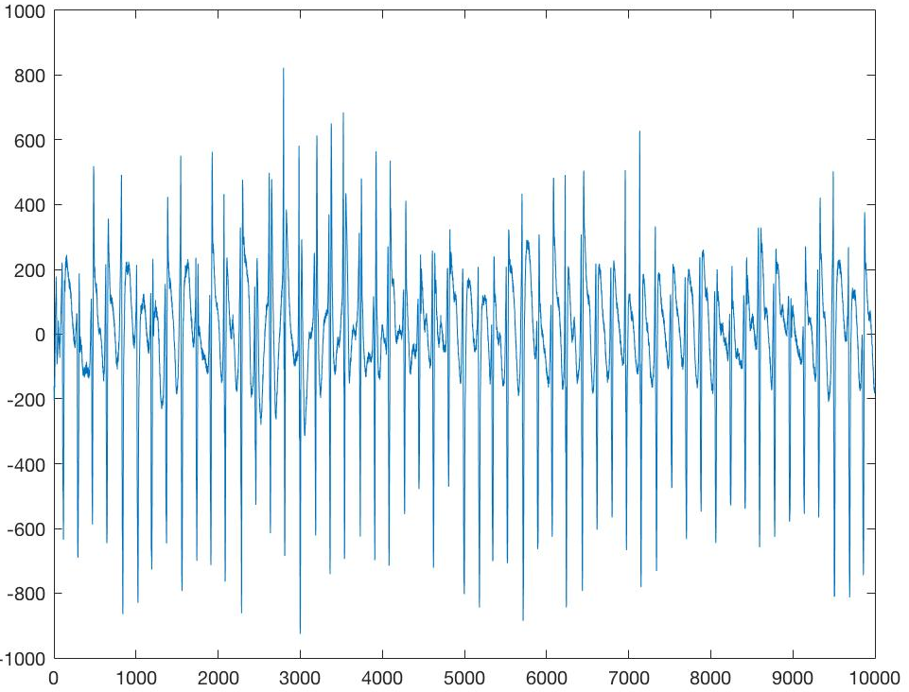
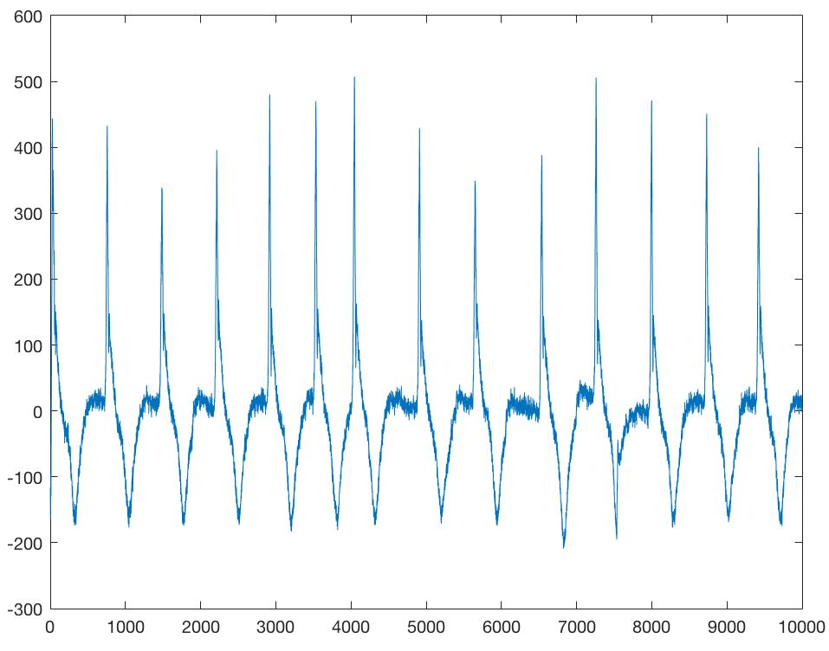
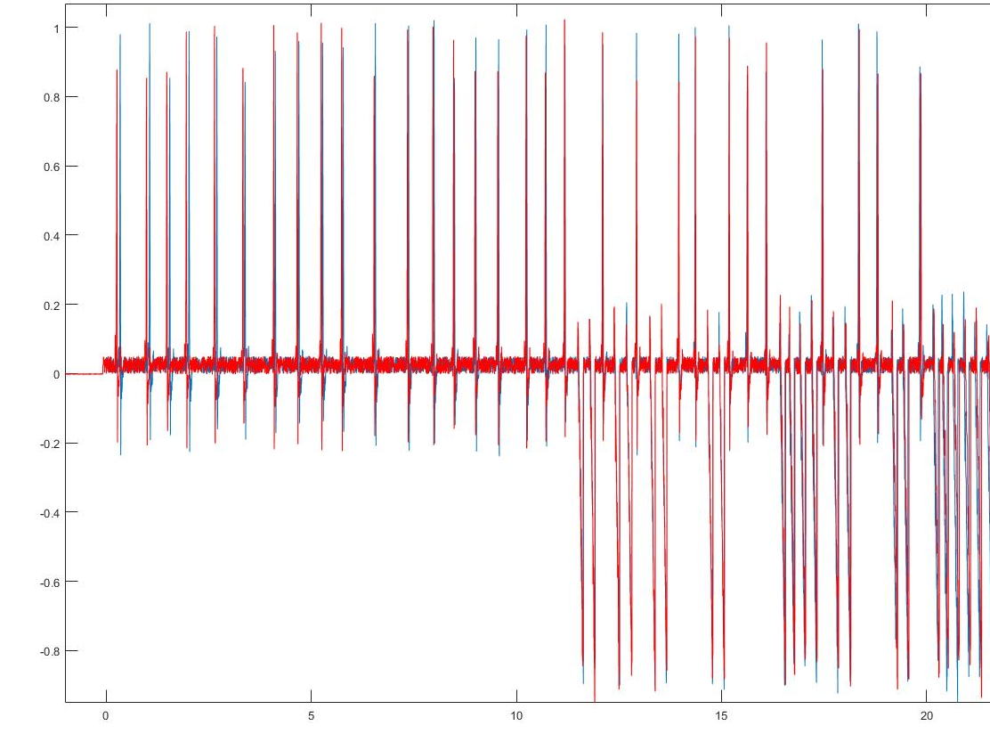
Hardware in the loop testing: ICD
The scenario is fed to a commercial ICD
Atrial signal
Commercial ICD
Ventricular signal
Heart Model
Shock signal
Notes:
Now in the case of the commercial device, the three signals Atrial Ventricular and shock are fed to the device. The shock signal is also used as feedback for the toolchain.

Slide 10
Hardware in the loop testing: Open ICD
The scenario is fed to our implementation of an ICD algorithm (Open ICD)
Atrial signal
Ventricular signal
Hearth Model
Shock signal
Open ICD
Data acquisition & Shock Generation
f_{sample} = 1 kHz
DAQ – USB

Slide 11
Toolchain

Slide 12
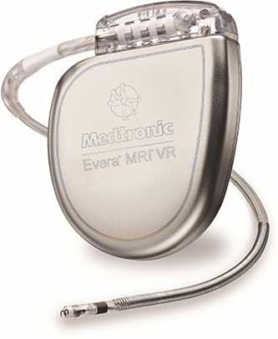
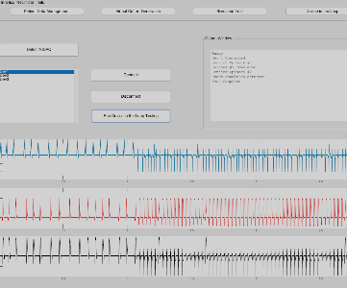
System Block Diagram
-7mV +7 mV
A
16 BIT
DAC
1 KHz
Atrial
Amplifiers
V
USB
SPI
Ventricular
S
Shock
Shock Feedback
Shock Feedback
Shock Protection Circuit
ADC
Shock
800 V – 30 J
Microprocessor
Analog Front End

Slide 13
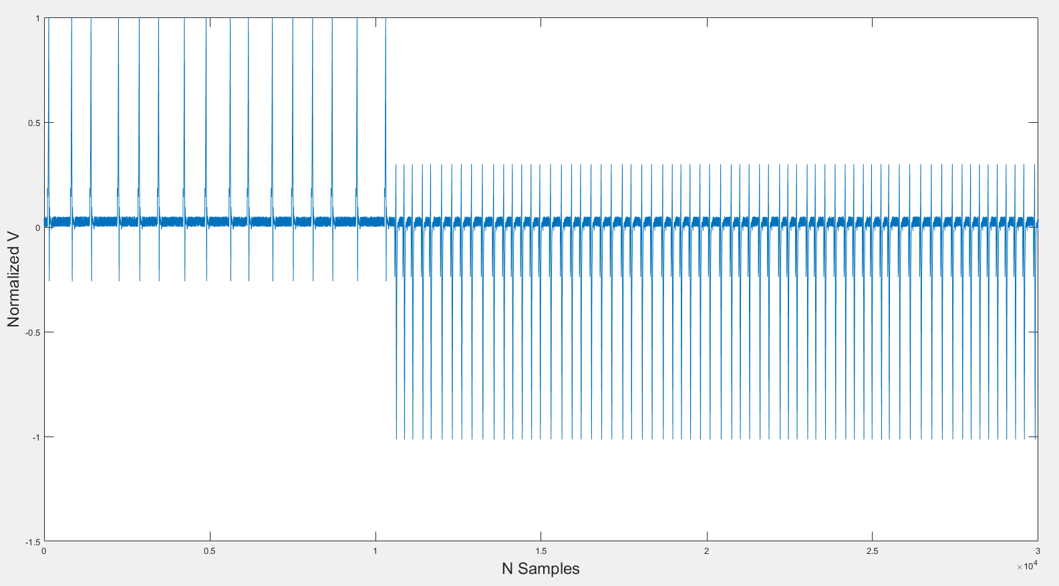
Signal Pipeline: Normalized AAEL

Slide 14
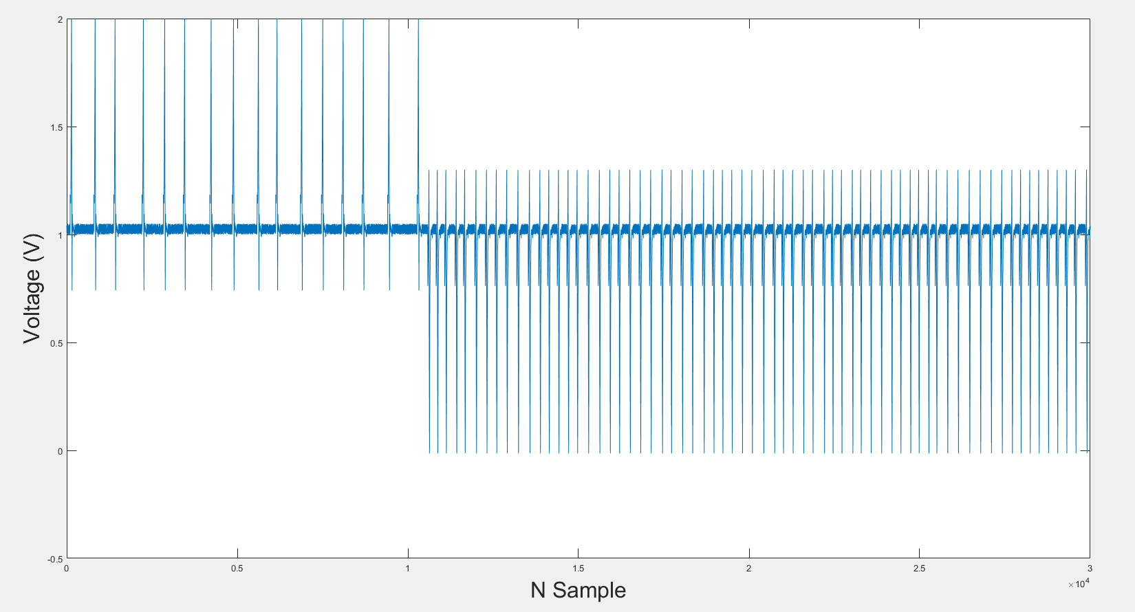
Signal Pipeline: DAC Output

Slide 15
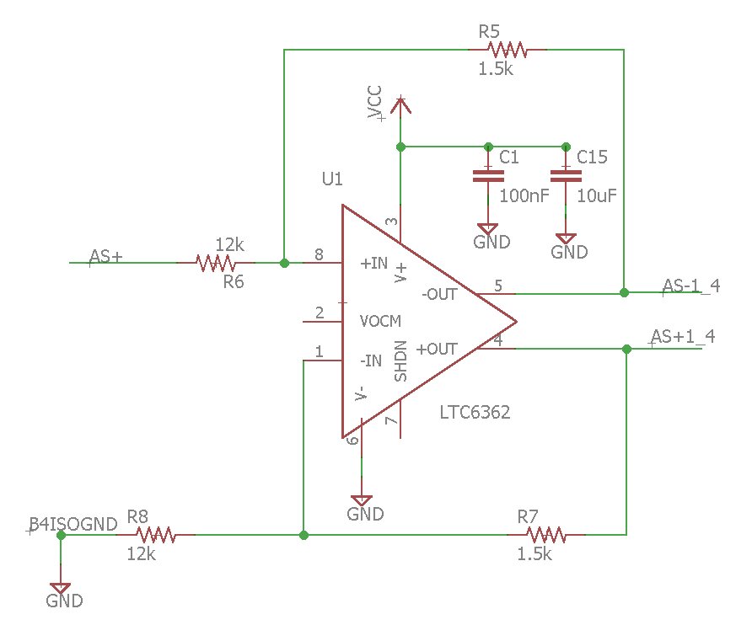
Attenuation Stage
DAC
Attenuation Stage
(1/8)
Analog Isolation Amplifier ( X 8)
Signal Shifting ( ± 1 V ) and buffering
Attenuation Stage
( 2/3)

Slide 16
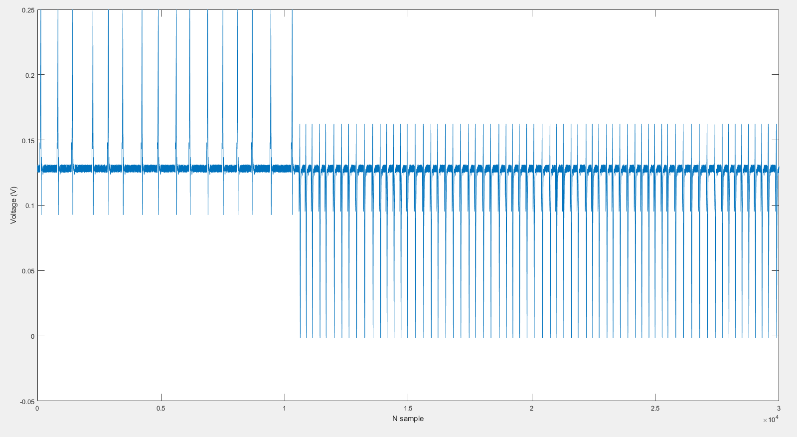
Attenuation Stage
DAC
Attenuation Stage
(1/8)
Analog Isolation Amplifier ( X 8)
Signal Shifting ( ± 1 V ) and buffering
Attenuation Stage
( 2/3)

Slide 17
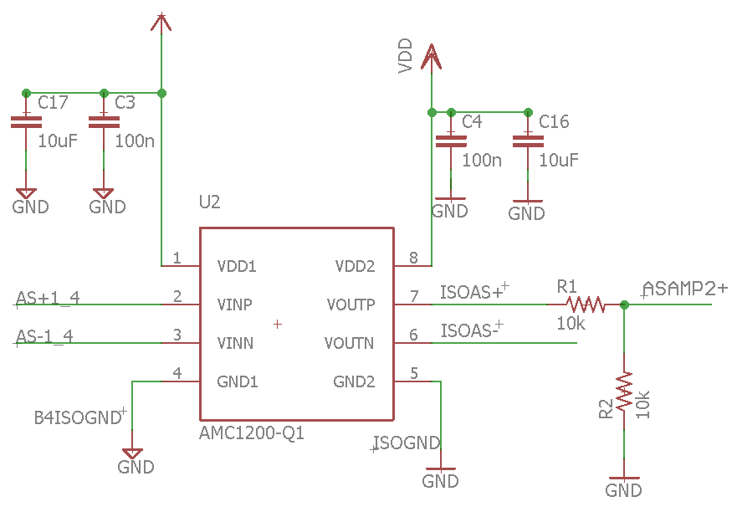
Analog Isolation Amplifier
DAC
Attenuation Stage
(1/8)
Analog Isolation Amplifier ( X 8)
Signal Shifting ( ± 1 V ) and buffering
Attenuation Stage
( 2/3)

Slide 18
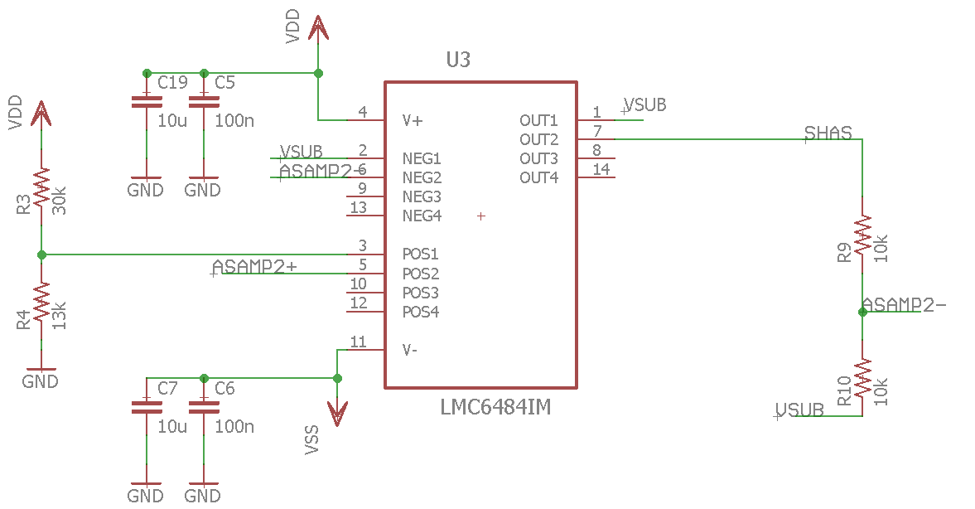
Shifting and buffering
DAC
Attenuation Stage
(1/8)
Analog Isolation Amplifier ( X 8)
Signal Shifting ( ± 1 V ) and buffering
Attenuation Stage
( 2/3)

Slide 19
DAC
Attenuation Stage
(1/8)
Analog Isolation Amplifier ( X 8)
Signal Shifting ( ± 1 V ) and buffering
Attenuation Stage
( 2/3)

Slide 20
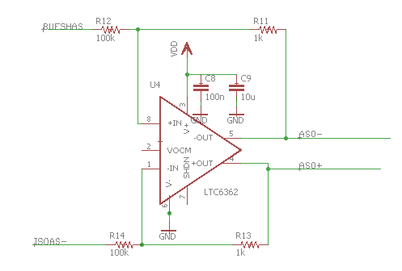
Attenuation
DAC
Attenuation Stage
(1/8)
Analog Isolation Amplifier ( X 8)
Signal Shifting ( ± 1 V ) and buffering
Attenuation Stage
( 2/3)

Slide 21
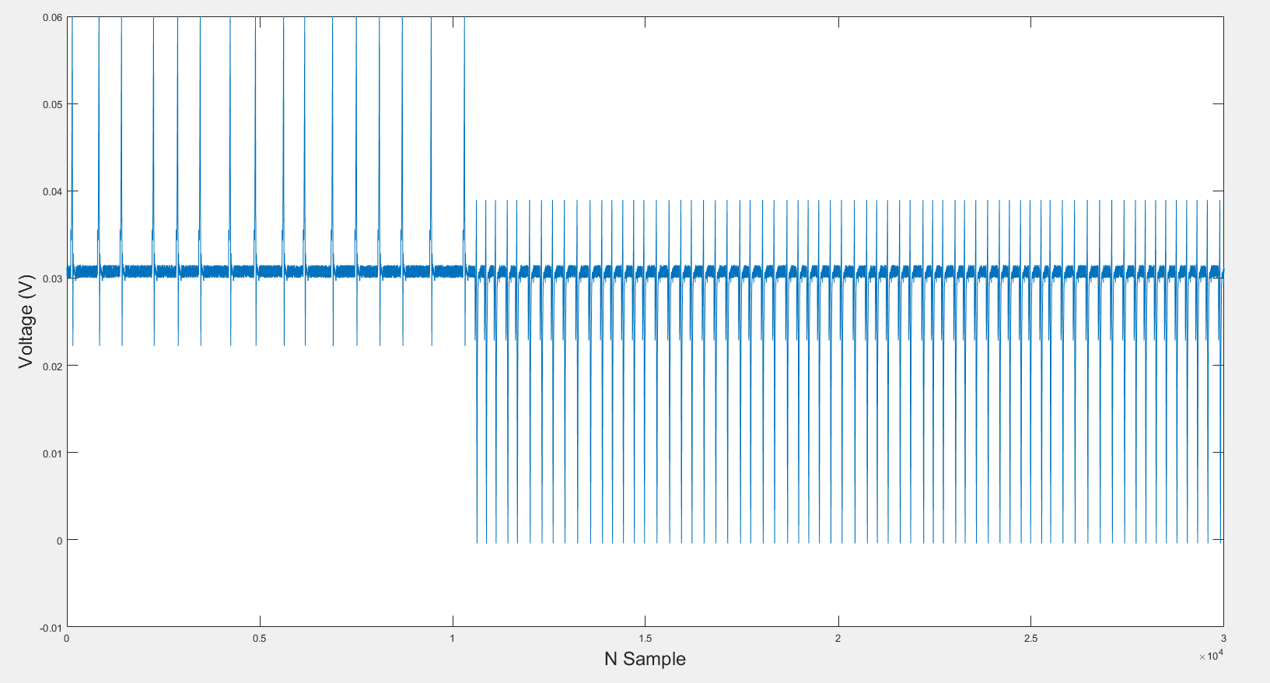
Attenuation
DAC
Attenuation Stage
(1/8)
Analog Isolation Amplifier ( X 8)
Signal Shifting ( ± 1 V ) and buffering
Attenuation Stage
( 2/3)

Slide 22
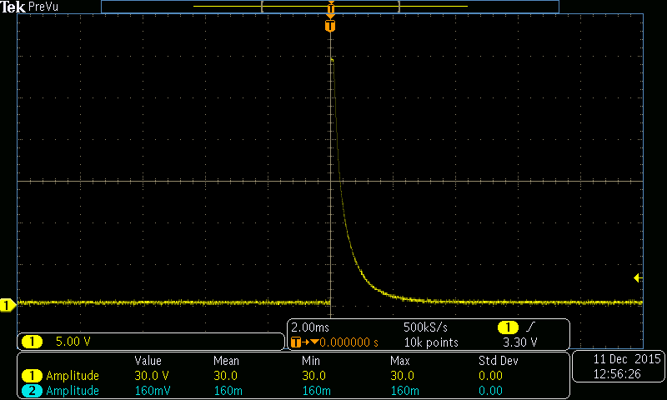
Shock Signal detection
800 V, t = 2 ms

Slide 23
Shock Protection and Attenuation
SHOCK PROTECTION Transient Voltage Suppressor (TVS) 8 V
ADC
Attenuation
Isolation

Slide 24
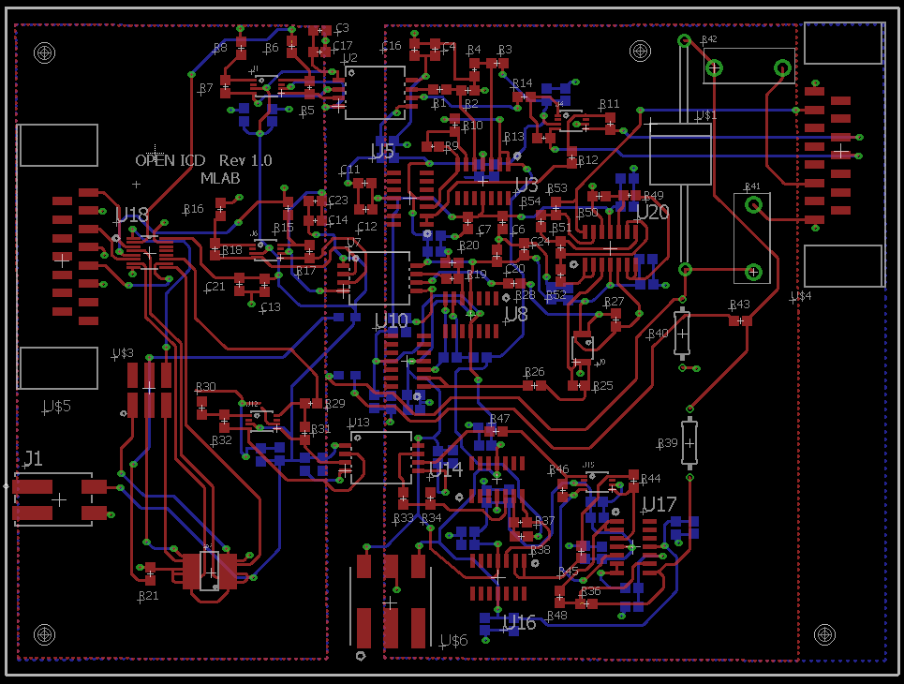
PCB Layout

Slide 25
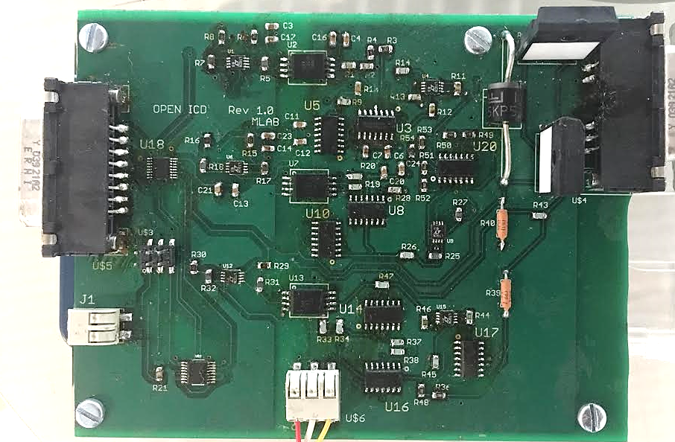
Attenuation
Attenuation
Isolation
Shifting and buffering
MUX
Shock Protection
DAC

Slide 26
Live Demo

Slide 27
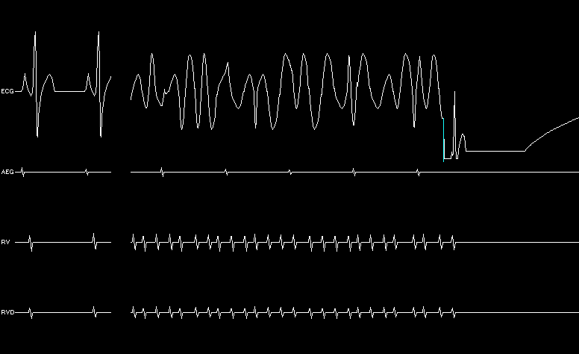
Scope Shock Protection Output
Shock Event

Slide 28
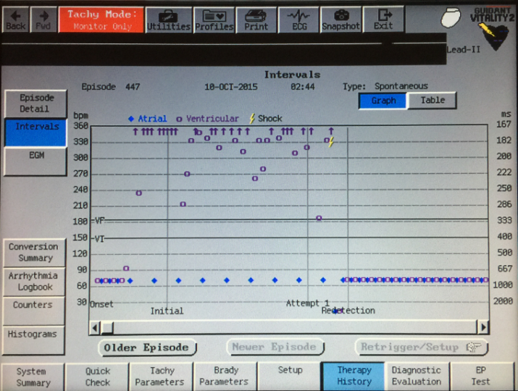
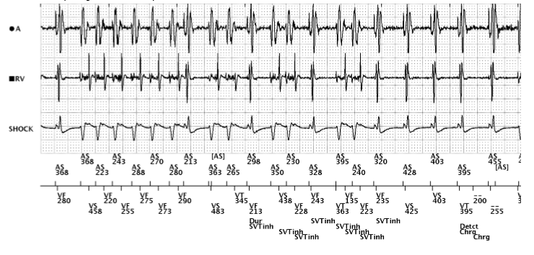
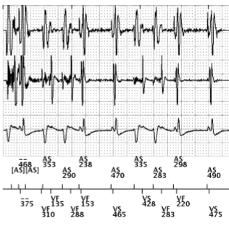
Inappropriate Shock Scenario
Commercial Device
Shock Event
Commercial Device
Shock Event

Slide 29
Inappropriate Shock Scenario: results
Open ICD Inhibit Output
Open ICD Shock Output
Shock Event

Slide 30
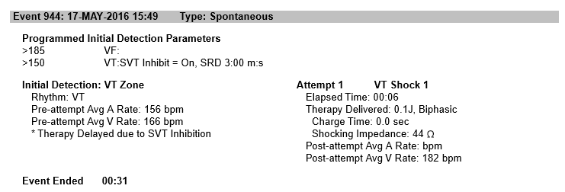
Inappropriate Shock Scenario: results
The commercial device and our open ICD delivered a therapy for the inappropriate shock scenario

Slide 31
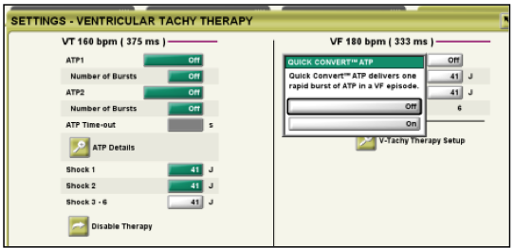
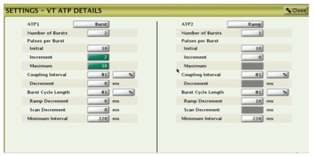
Research Directions
Testing multiple devices at the same time
Knowledge of the discriminator not black box testing
Sensitivity testing
Patient specific device parameter setting

