Slide 1
Data-driven Modeling of Intracardiac Electrograms
Kuk Jin Jang
with
Houssam Abbas⁽¹⁾, Zhihao Jiang⁽¹⁾, Jackson Liang⁽²⁾, Rahul Mangharam⁽¹⁾
⁽¹⁾ School of Engineering and Applied Sciences, University of Pennsylvania
⁽²⁾ Hospital of the University of Pennsylvania
Notes:
The case for generative models in testing of
medical cyber physical systems

Slide 2
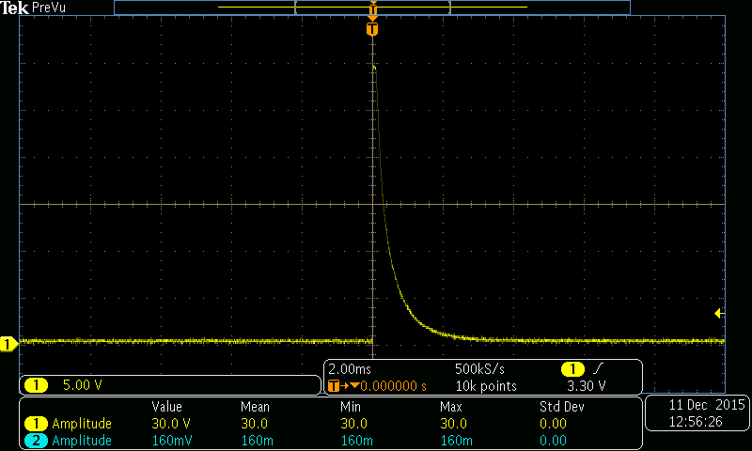
Implantable Cardioverter Defibrillator (ICD) Operation
Last 10 Ventricular intervals
Initial Detection
8/10 intervals faster
than VT threshold
No
No
8/10 intervals faster
than VF threshold
Yes
Yes
VT Duration
VF Duration
VT
RhythmID
V rate>A rate
by at least 10bpm
No
VTC
Correlated
Yes
Yes
No
SVT
VT
No
A-fib Rate=TRUE
& V rate unstable
Yes
Sensing:
Measure physiological state
Discrimination:
Determine physiological state
Therapy:
Apply therapy to patient

Slide 3
Discrimination (Classification) Accuracy is important to evaluating ICD performance
Last 10 Ventricular intervals
Initial Detection
8/10 intervals faster
than VT threshold
No
No
8/10 intervals faster
than VF threshold
Yes
Yes
VT Duration
VF Duration
VT
RhythmID
V rate>A rate
by at least 10bpm
No
VTC
Correlated
Yes
Yes
No
SVT
VT
No
A-fib Rate=TRUE
& V rate unstable
Yes
Sensing:
Measure physiological state
Discrimination:
Determine physiological state
Therapy:
Apply therapy to patient

Slide 4
Data availability presents a challenge for evaluation of discrimination algorithms
Limited availability of data
  Data – electrogram episodes of various conditions
Available data is incomplete
  Episode label is missing
  Episode is too short

Slide 5
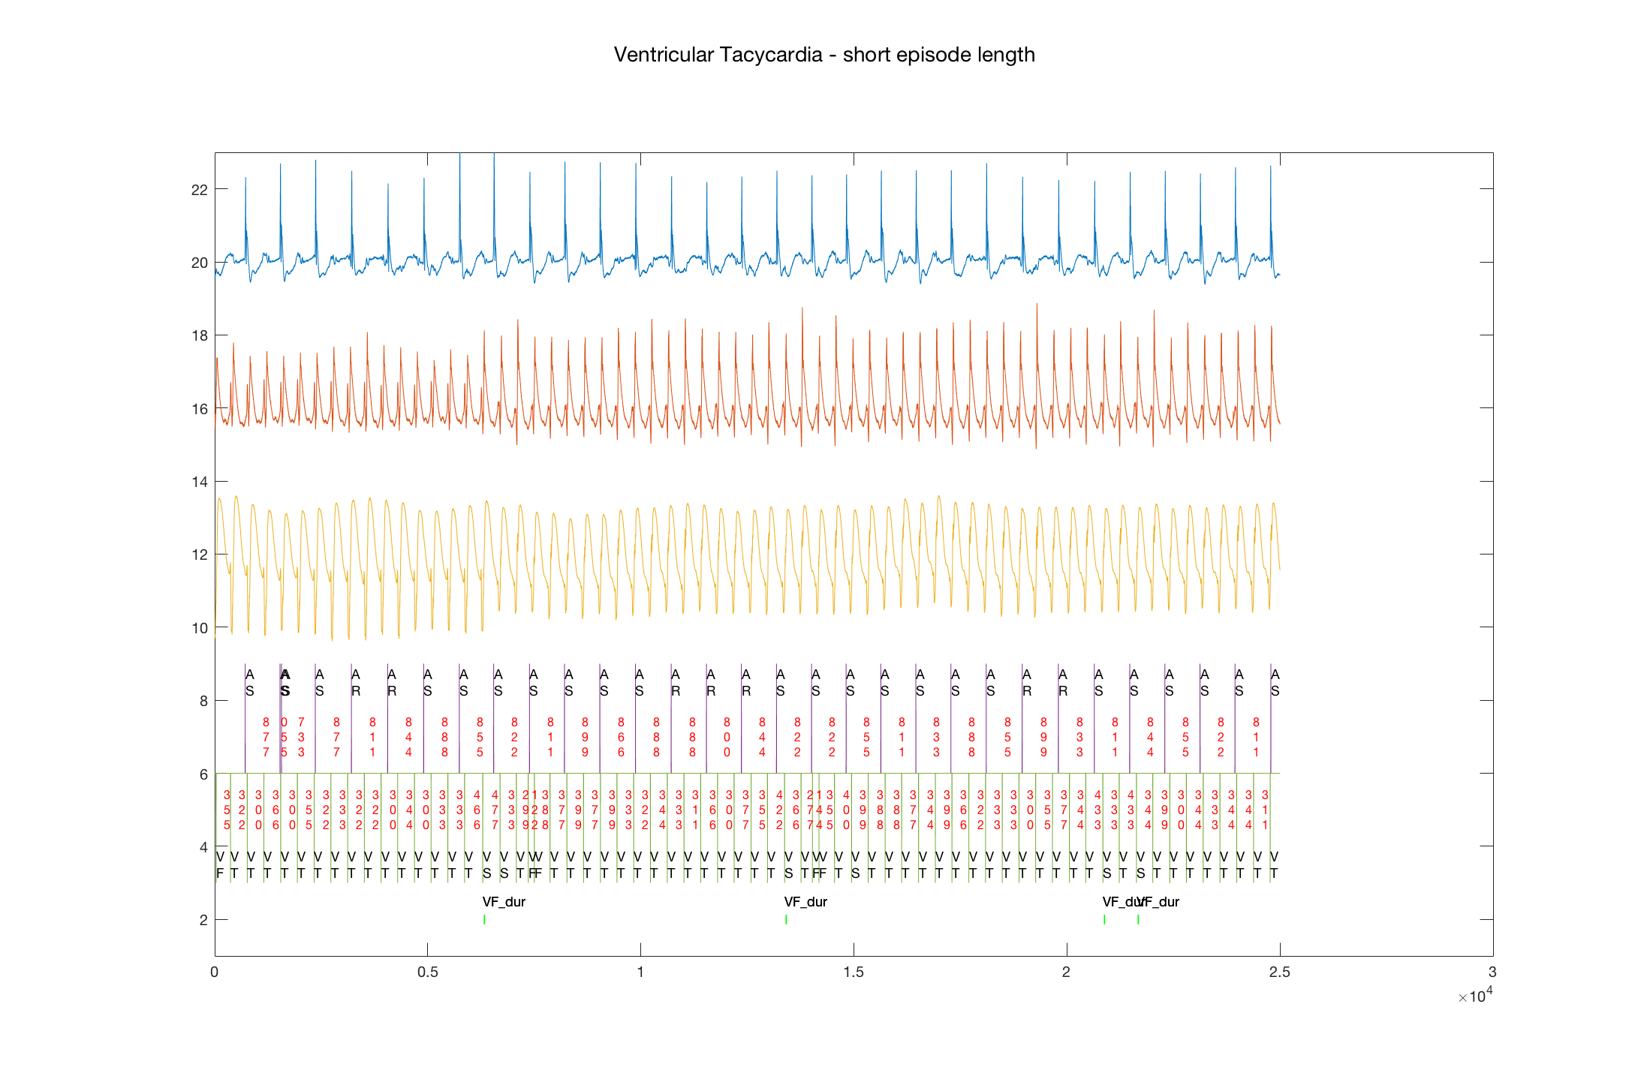
Example: Incomplete data
Algorithm is aware of VT condition
The EGM episode ends before the discrimination algorithm can output decision

Slide 6
Our approach:
Data-driven models → generative models
Learn a generative model from set of electrograms
  Generative model learns an empirical distribution that can be sampled
Subsequently,
Generative model is sampled to produce new electrograms
  New electrograms are similar to original set
  Satisfy requirements for use in discrimination algorithm evaluation

Slide 7
EGM Modeling with Long Short-term Memory (LSTM) Networks
Neural Nets
RNNs
Output determined by current timestep only
Output determined by current timestep &
Previous state

Slide 8
LSTM Network
Long short-term memory (LSTM) Networks are an extension of RNNs to allow for modeling of long term dependencies
‘Forget’ gate
‘Input’ gate
‘Output’ gate
Cell state vector
RNN
LSTM
(Diagram from Colah, “Understanding LSTM Networks”, 2015 )

Slide 9
LSTM Network Architecture

Slide 10
LSTM Network Architecture - Advantages
Relations between channels is implicitly modeled through the network.
Channel output easily extended
Ease of multi-dimensional input

Slide 11
Training setup

Slide 12
EGM Generation

Slide 13
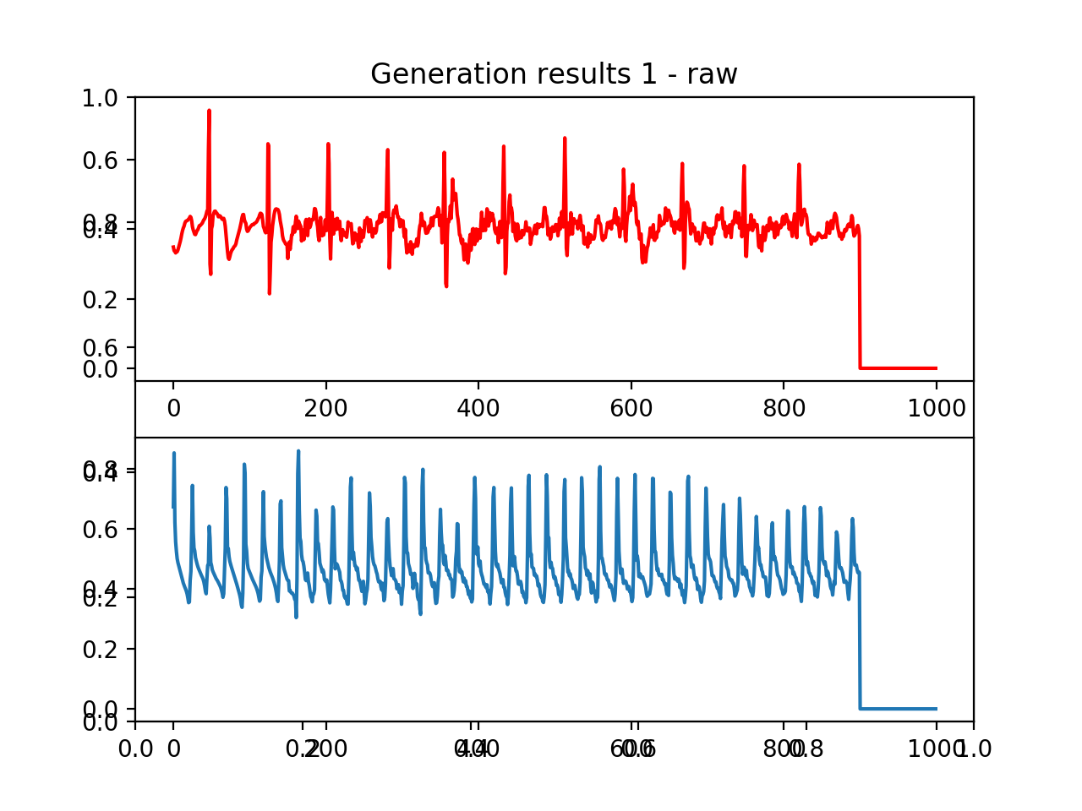
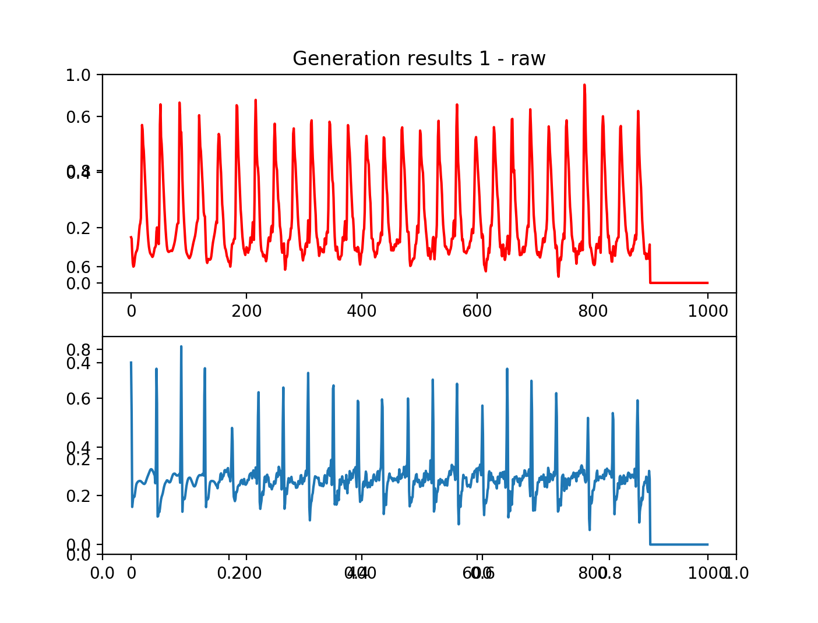
Initial Results
Modeling of VT
Modeling of SVT

Slide 14
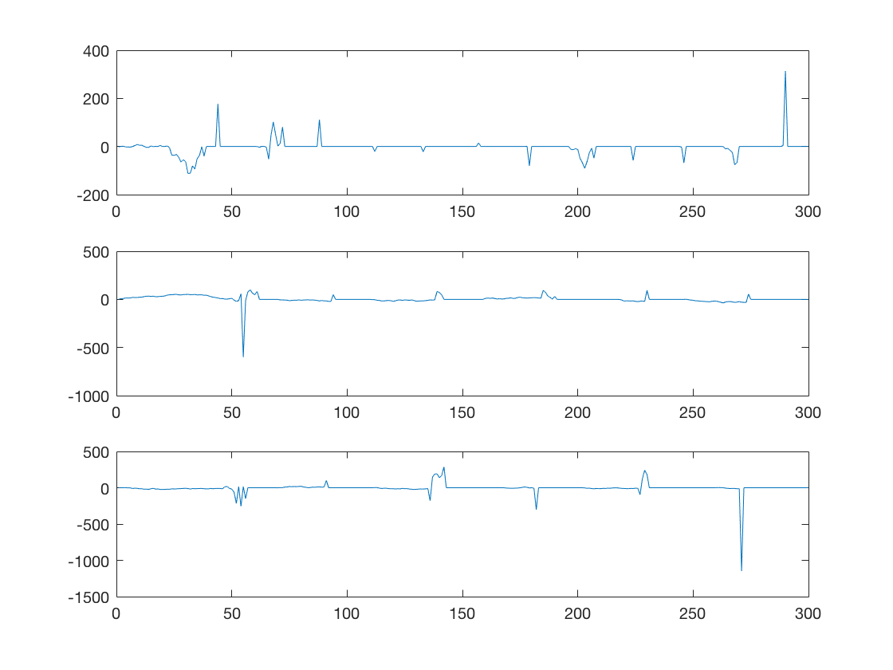
Previous attempt…

Slide 15
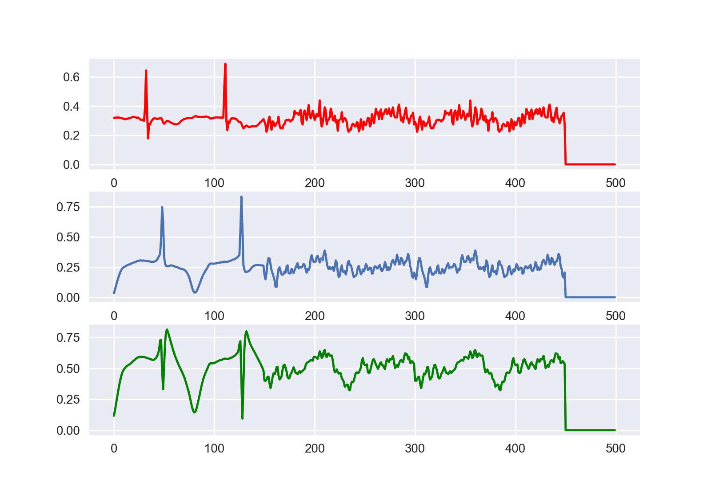
Initial Results: Limitation of RNN
RNNs are unable to cover long term dependencies:

Slide 16
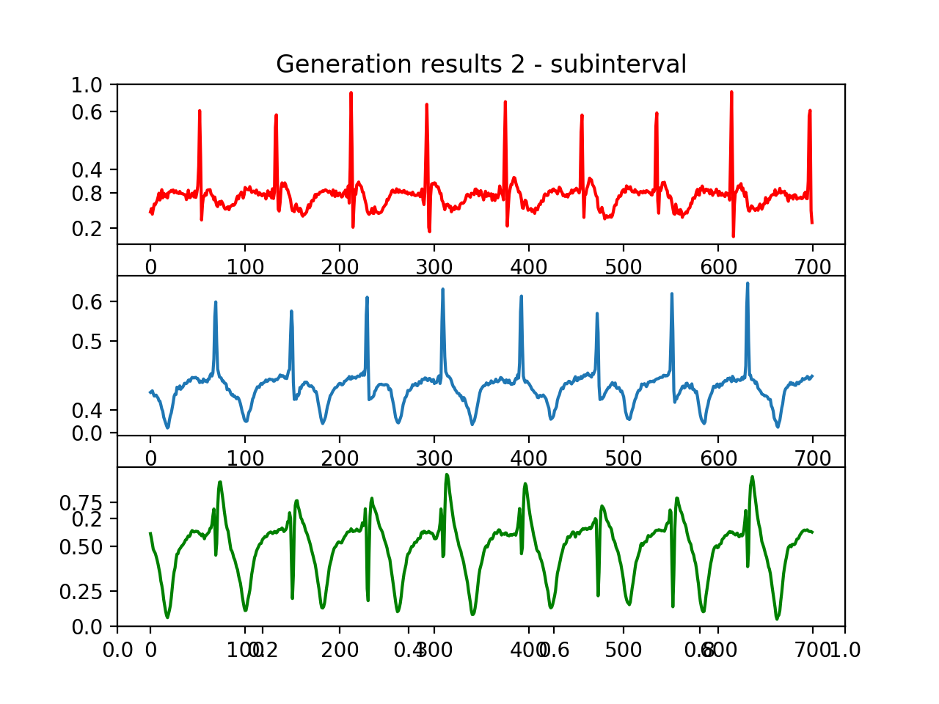
Initial Results
Multi-channel modeling of NSR

Slide 17
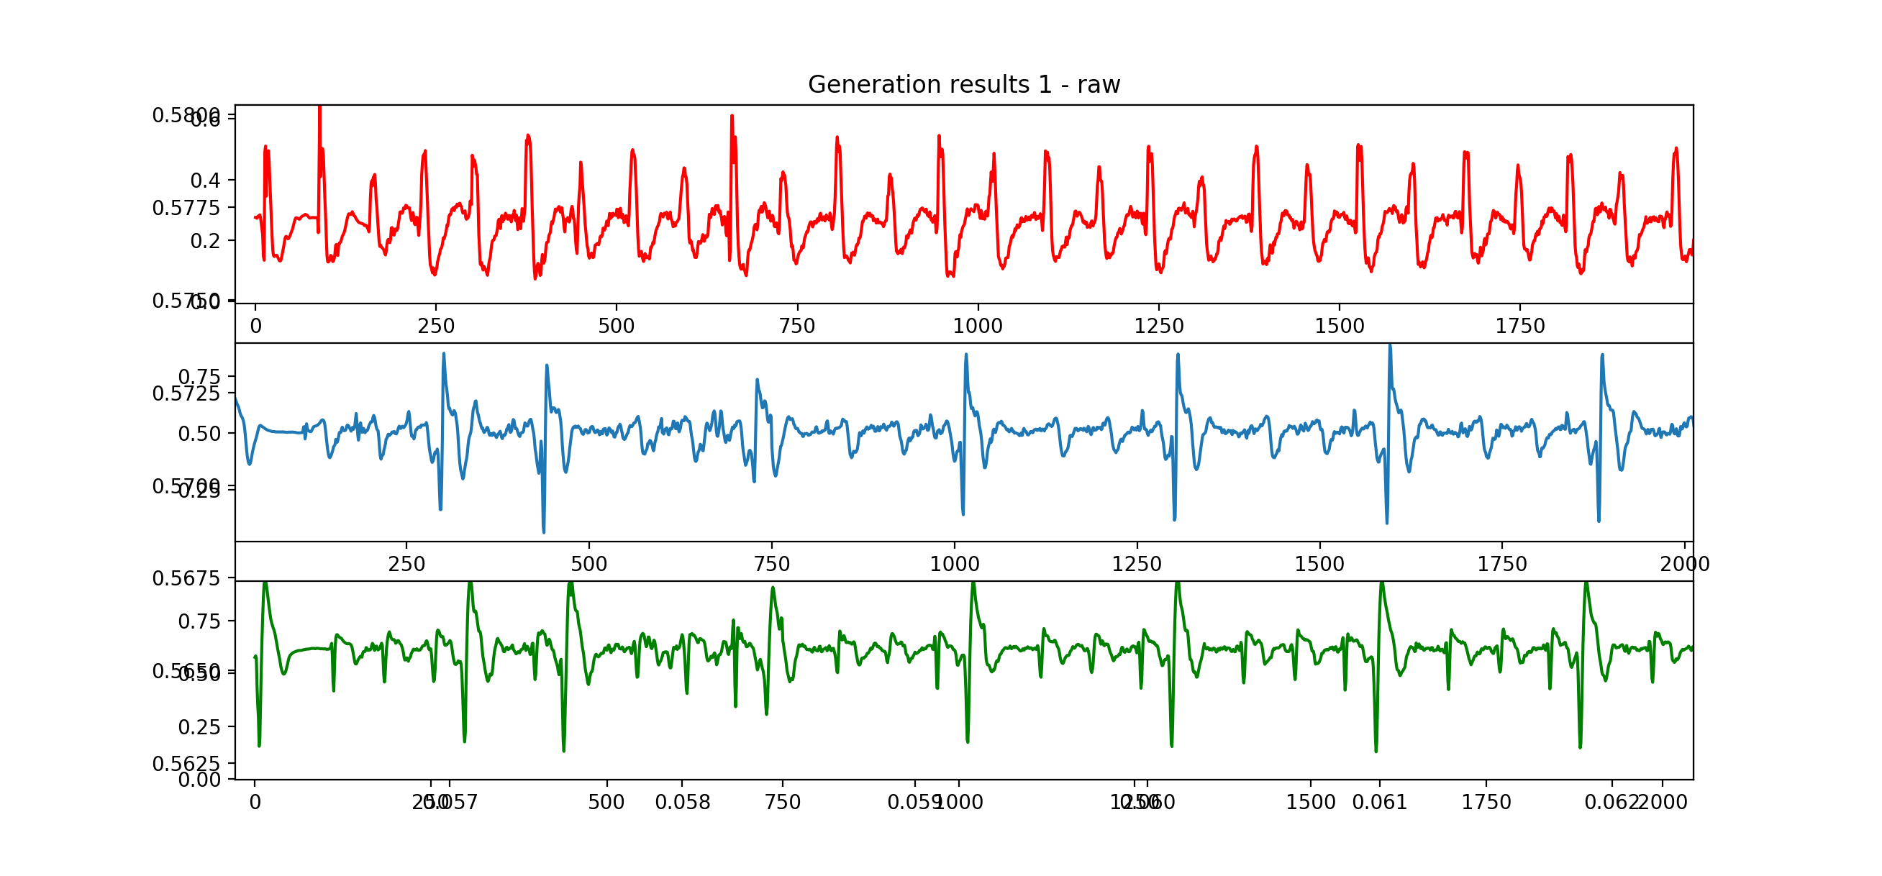
Initial Results
NSR with occasional premature ventricular contraction (PVC)

Slide 18
Next steps: From LSTM Networks to Generative Models
Generative Adversarial Networks – Supervised learning to learn the distribution of a given dataset
Classifier determines whether generated example is from data distribution
Generative model attempts to generate examples which fool the classifier

Slide 19
Next steps: From LSTM Networks to Generative Models
Evaluation of discrimination algorithm

Slide 20
Conclusion
Generative models provide a potential solution for limitations in data for evaluation of ICD discrimination algorithms
LSTM networks are effective at modeling intracardiac electrograms.
Future: GAN framework combined with LSTM networks to develop a generative model of electrograms.

Slide 21
Extra Slides

Slide 22
Initial Results: Limitation of RNN
RNNs are unable to cover long term dependencies:

Slide 23
LSTM Network Walkthrough

