Slide 1
Formal Methods for Cyber-Physical Systems
Rance Cleaveland
Department of Computer Science

Slide 2
The CyberCardia Project
In silico / “heart-ware-in-the-loop” design for cardiac devices
Use models of devices, heart behavior to drive early design, enable V&V
Replace models with hardware / software later in design cycle
Why? Model-based development

Slide 3
Benefits of MBD
Requirements
Final test
models
Specifications
System test
models
Design
Unit test
Implementation
Models formalize specifications, design
Models facilitate communication among teams
Models support V&V, testing

Slide 4
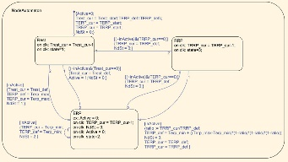
Model Checking
Given
Model
Behavioral spec
Prove automatically
Does model satisfy spec
Related problems
Model synthesis
Specification synthesis
Specification discovery
C
P
$AG$ arrhythmia $⇒{\text{AF}}_{≤5}$ pacing
AG ? $⇒{\text{AF}}_{≤5}$ pacing

Slide 5
UMD Work in 2017
Invariant mining from test data
Given test data, propose invariants
Talk later by C. Schulze will report on recent results, including preliminary work with UPenn models
Paper submitted for publication
Temporal logic query checking
Given (finite-state) model, LTL template (= formula with “hole”, e.g. AG ? $⇒{\text{AF}}_{≤5}$ pacing)
Solve for “hole”
Talk later by S. Huang will describe recent results
Paper in preparation

Slide 6
UMD Work in 2017 (cont.)
Model checking for singular hybrid automata
Existing model-checking work
Complex properties (e.g. mu-calculus) for simple (finite-state) systems
Simple properties (e.g. reachability) for complex (e.g. non-linear systems)
What about more complex properties for somewhat less complex systems?
Singular hybrid automata generalize timed automata, can approximate e.g. hybrid automata with ODE mode dynamics
With J. Keiren (Open Univ., the Netherlands) have developed on-the-fly model checking technique
Based on earlier work on timed automata
Handles full mu-calculus
Paper in preparation
Implementation in progress

Slide 7
Thanks!
rance@cs.umd.edu

