Slide 1
Multi-Parameter Bifurcation Analysis of Cardiac Alternans
Ariful Islam
Collaborators: Radu Grosu, Rance Cleaveland, Flavio Fenton and Scott Smolka
2017 NSF Frontiers CyberCardia Annual Meeting
Penn, April 14

Slide 2
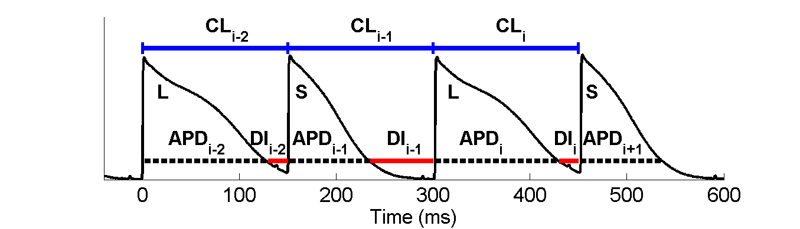
Cardiac Alternans
At the cellular level, alternans appears as a beat-to-beat long (L)-short (S) alternation despite a constant pacing period (cycle length CL).
Action potential duration (APD) and/or amplitude may alternate.
DI: Diastolic Interval
Cherry EM, Fenton FH. 2008. New Journal of Physics 10, 125016.

Slide 3
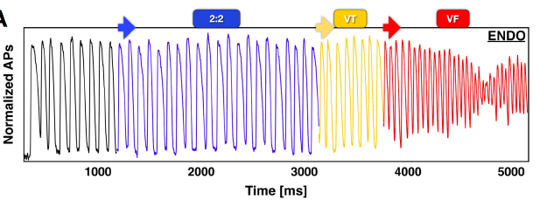
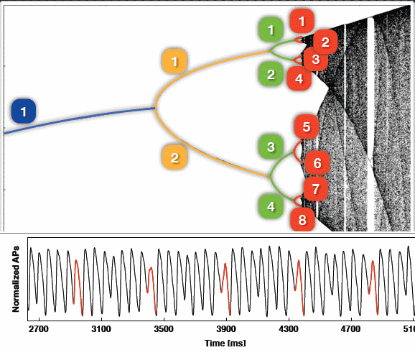
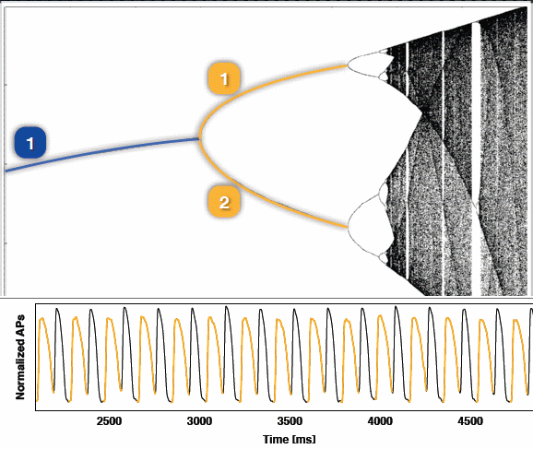
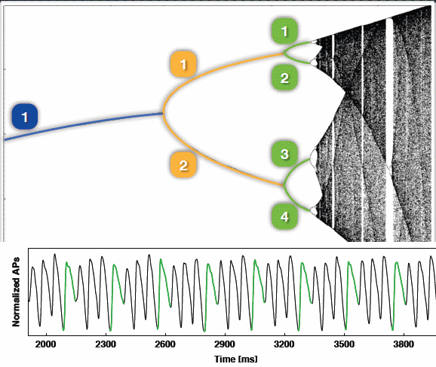
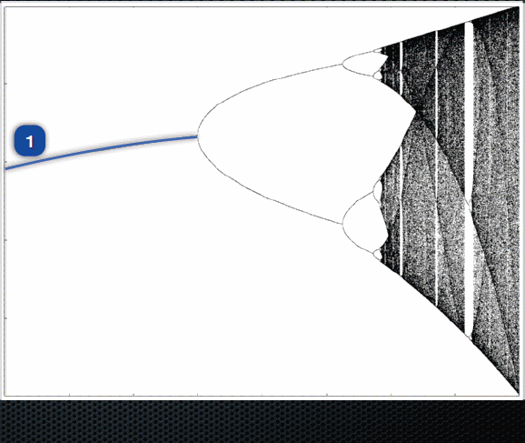
Alternans often Leads to Fibrillation
Optical recordings: APDs alternate
Data from canine right ventricles paced at faster and faster periods
Notes:
2:2 : period doubling
VT: Ventricular tachycardia
VF: Ventricular Fibrillation

Slide 4
Analyzing Alternans
Restitution Curve:
APD vs DI curve
Slope > 1: alternans
Bifurcation Diagram:
APD vs BCL
Two APDs for same BCL indicates existence of alternans (period-doubling)
Notes:
1. Alternans characteristics: can be explained by restitution curve and bifurcation diagram
2. Briefly mention the bulleted points and highlight them in the figure
Finally please mention that we are going to use bifurcation analysis in this work

Slide 5

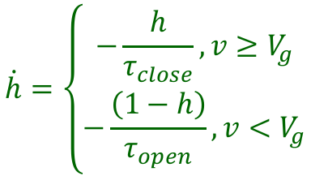


Alternans in Mitchell-Schaeffer (MS) Cardiac- Cell Model
$$\dot{h}=\left\{\begin{aligned}−\frac{h}{τ_{close}}, v≥V_{g} \\ −\frac{\left(1−h\right)}{τ_{open}}, v<V_{g}\end{aligned}\right.$$
$$\dot{v}=\frac{hv^{2}\left(v−1\right)}{τ_{in}}−\frac{v}{τ_{out}}+I_{s}(t)$$
Cell Dynamics:
$$I_{s}$$
$$τ_{s}$$
BCL
$$t$$
Notes:
MS model: simple, easy to analyze, capable of producing alternans with the variation of its parameter.
2. Brief explanation of the bifurcation diagram for BCL generated by simulation
3. Limitation of simulation-based approach
4. Goal: explain the power of formal methods over simulation

Slide 6




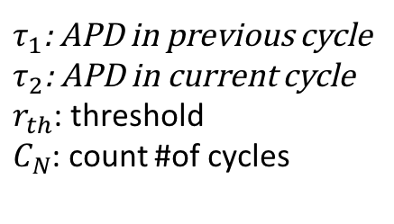
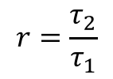
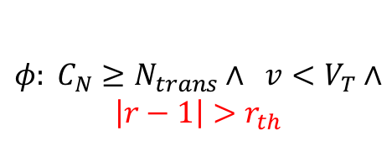

















Encoding Alternans: Observer Automaton
$τ_{1}$: APD in previous cycle
$τ_{2}$: APD in current cycle
$r_{th}$: threshold
$C_{N}$: count #of cycles
Stimulus Mode 1
APD Mode
$$\dot{C_{N}}=0$$
$$\dot{C_{N}}=0$$
$$\dot{τ_{1}}=0$$
$$τ≥τ_{s}:$$
$$\dot{τ_{1}}=0$$
$$\dot{τ_{2}}=0$$
$$τ_{1}′=0$$
$$\dot{τ_{2}}=1$$
$$τ≤τ_{s}$$
$$v≥V_{T}$$
$$ϕ$$
$$r=\frac{τ_{2}}{τ_{1}}$$
$$v≥V_{G}$$
$$v<V_{T}$$
Trap
Alternans:
$$\dot{C_{N}}=0$$
$$\dot{C_{N}}=0$$
$$\dot{τ_{1}}=0$$
$$τ≥BCL:$$
$$\dot{τ_{1}}=0$$
$φ:{ C}_{N}≥N_{trans}∧ v<V_{T}∧$
$$\left|r−1\right|≤r_{th}$$
$$\dot{τ_{2}}=0$$
$$\dot{τ_{2}}=0$$
Trap Mode
$$c_{N}^{′}=c_{N}+1$$
$$τ_{1}^{′}=τ_{2}$$
$$v≤V_{G}$$
$$τ≤BCL$$
Non-Alternans:
Stimulus Mode 2
Non-APD Mode
$φ: C_{N}≥N_{trans}∧ v<V_{T}∧$
$$\left|r−1\right|>r_{th}$$
Checking Alternans: Is Trap mode reachable from any initial state?
Notes:
Observer automaton: it observes voltage signals from the MS model and determine whether it exhibits alternans
To compute APD of two consecutive APDs, we add two variables: \tau_1 and \tau_2 in the automaton
To count transient periods, we add additional variable C_N
Top row encode the transition period: After each BCL, it increases C_N by 1 and remains there until N_trans+1 times
Before moving into next row, the observer measure \tau_1 in ‘’APD Mode: 2’’
In ‘’APD Mode: 6’’, it computes \tau_2
If condition for the alternans violates, it moves into the trap mode
If the condition satisfies for this consecutive AP cycles, it rotate back for the next AP cycle. Before move into the next cycle, \tau_1 is set to \tau_2
All the green state in the automaton are the acceptance states

Slide 7
Single-Parameter Bifurcation Analysis using dReach
CMSB’16
Notes:
AR: Alternans region, NR: Non-alternans Region, UR: Uncertainty Region, \delta_0: initial chosen delta for dReach
Algorithm 1 split the parameter range into three parts: AR, NR and UR that contains bifurcation point
Initial we consider the entire range as UR
We then iteratively refine UR using recursive search procedure until it meets a predefined precision criteria
In line 3, we first run dReach to solve problem (1) [previous slide]: if it returns unsat then we set the range as NR and return
In line 8, we run dReach to solve problem (2) [previous slide]: if it returns unsat then we set the range as AR and return
The part from 13, indicates that both \alpha and \beta is \delta-sat:
In line 13, we check whether the size of UR is less than delta: if not, it implies that current delta can not refine UR anymore
We bisect UR and recursively call the search algorithm and return the union of their as UR

Slide 8




Algorithm in Action
Exact Bifurcation Point:
Green: Non-alternans
Red: Alternans
$$\underline{τ}$$
$$τ′$$
$$\overline{τ}$$
Bifurcation Analysis using our Algorithm:
UR
0)
1)
2)
3)
4)
$$⋮$$
n)
New UR
Notes:
In the beginning:
Let’s say this is the exact bifurcation analysis where \tau’ is the bifurcation point and red region is AR and green region is NR
Our algorithm will find iteratively search this point. But finding exact point is undecidable, we rather find a small region, we can UR, such it contains \tau’
After the click: the execution of recursive search for a given delta
0. We consider the entire range as an UR, we call dReach for (1) and (2), both return delta-sat. So we bisect the region
Left region return delta-sat, but the right region returns unsat for (1), so we don’t search anymore on the right region
This time both sections return delta-sat, so we bisect them both
Explain the upto 4 in the same manner
After getting new UR, Algorithm 1 reduces delta and do the recursive search again.. So finally in n-step, we split the region into three parts: AR, NR, and UR

Slide 9
Multi-Parameter Bifurcation Analysis using sReach (Submitted to TCS)
TCS (Submitted)
Notes:
AR: Alternans region, NR: Non-alternans Region, UR: Uncertainty Region, \delta_0: initial chosen delta for dReach
Algorithm 1 split the parameter range into three parts: AR, NR and UR that contains bifurcation point
Initial we consider the entire range as UR
We then iteratively refine UR using recursive search procedure until it meets a predefined precision criteria
In line 3, we first run dReach to solve problem (1) [previous slide]: if it returns unsat then we set the range as NR and return
In line 8, we run dReach to solve problem (2) [previous slide]: if it returns unsat then we set the range as AR and return
The part from 13, indicates that both \alpha and \beta is \delta-sat:
In line 13, we check whether the size of UR is less than delta: if not, it implies that current delta can not refine UR anymore
We bisect UR and recursively call the search algorithm and return the union of their as UR

Slide 10
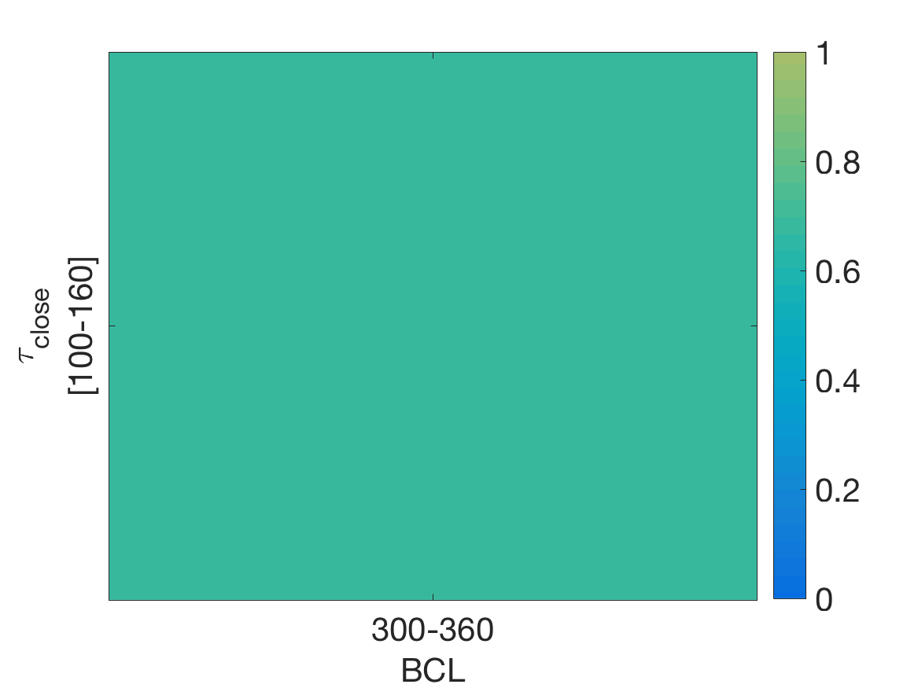
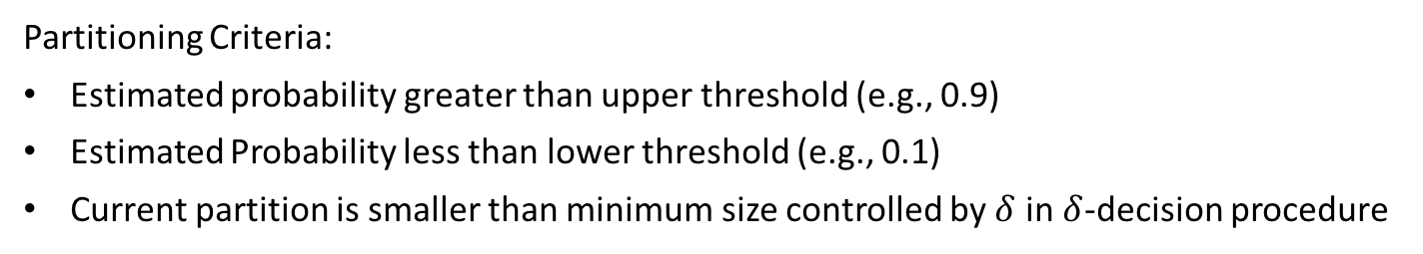
Algorithm Demonstration
What is the probability that a parameter will produce alternans?
160
100
300
360
360
Partitioning Criteria:
Estimated probability greater than upper threshold (e.g., 0.9)
Estimated Probability less than lower threshold (e.g., 0.1)
Current partition is smaller than minimum size controlled by $δ$ in $δ$-decision procedure

Slide 11
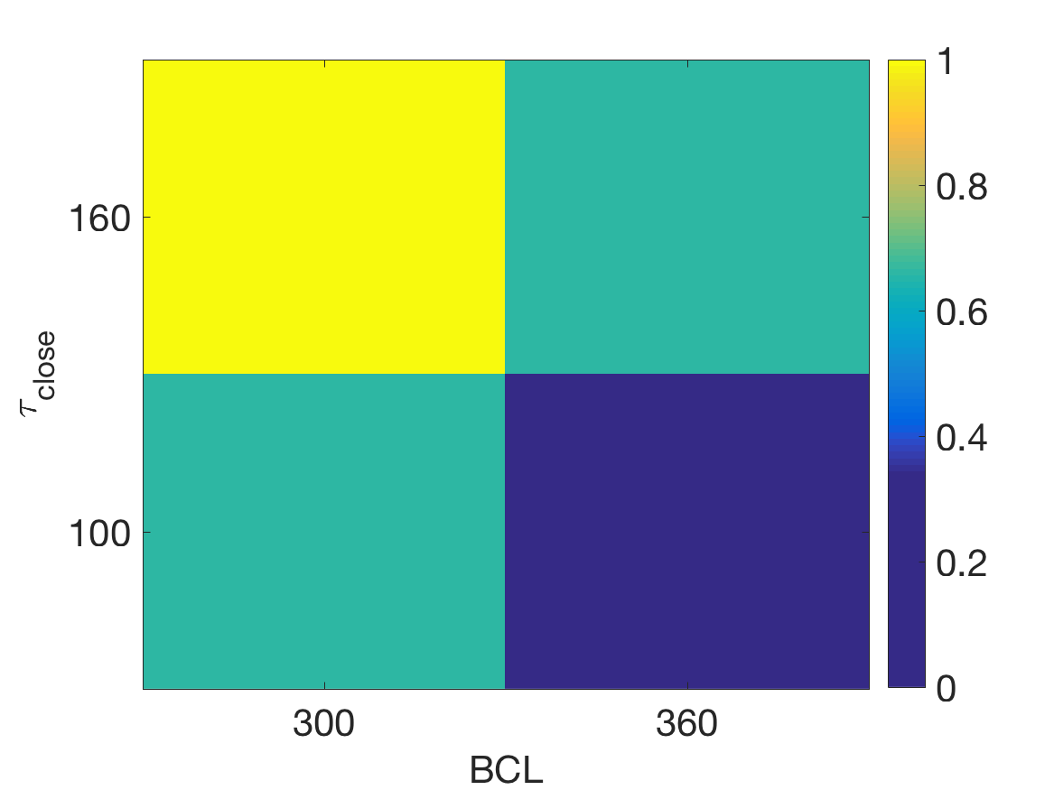
Algorithm Demonstration

Slide 12
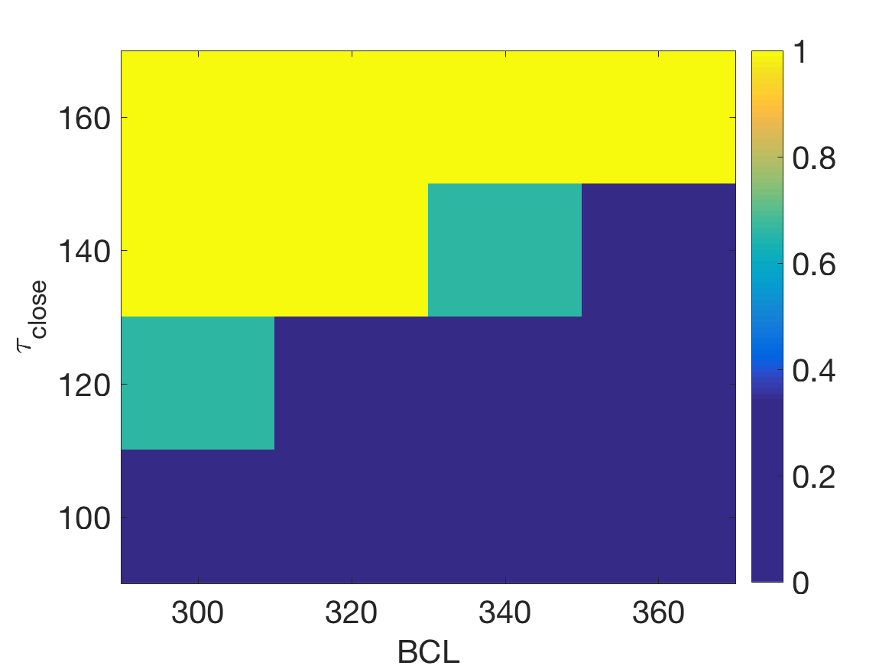
Algorithm Demonstration

Slide 13
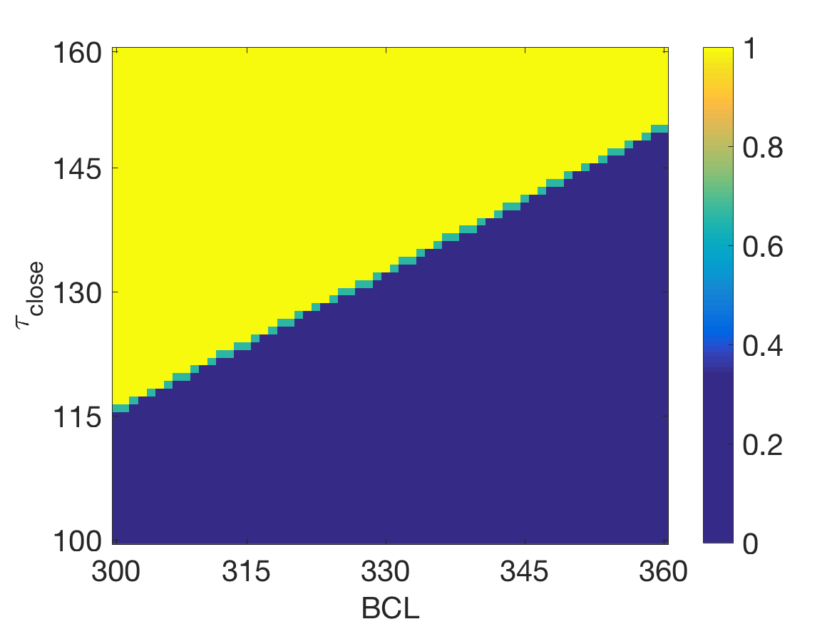
Algorithm Demonstration

Slide 14
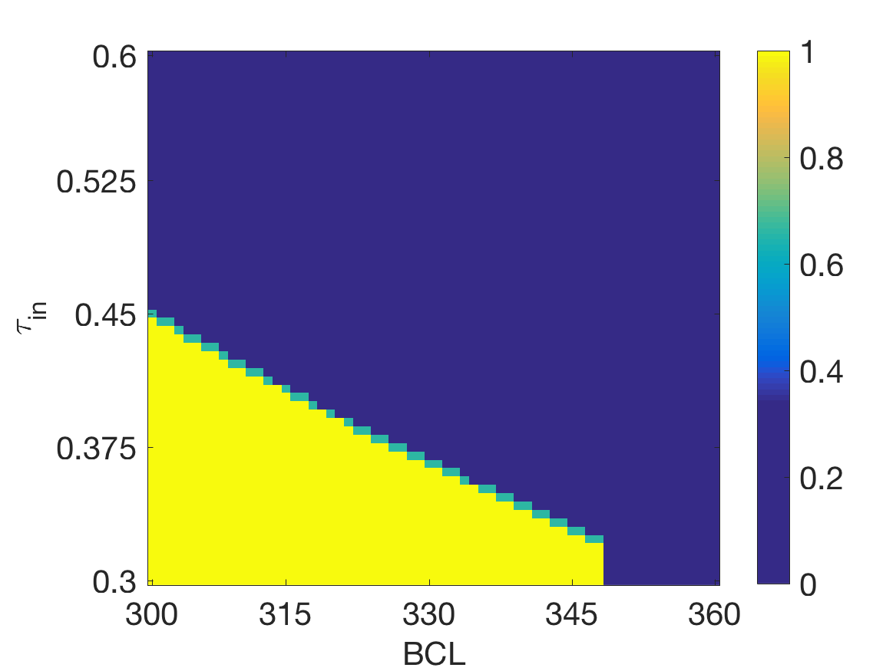
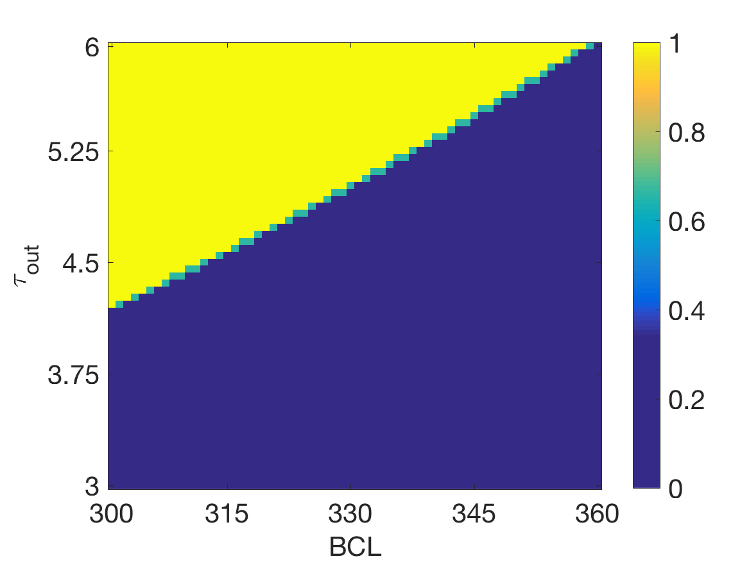
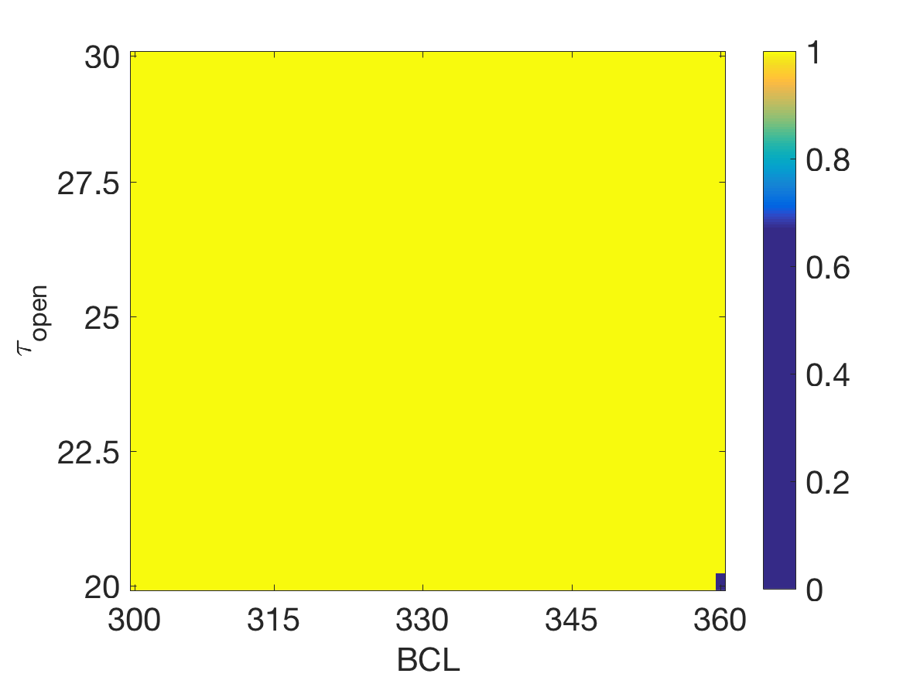
Two-Parameter Analysis

Slide 15
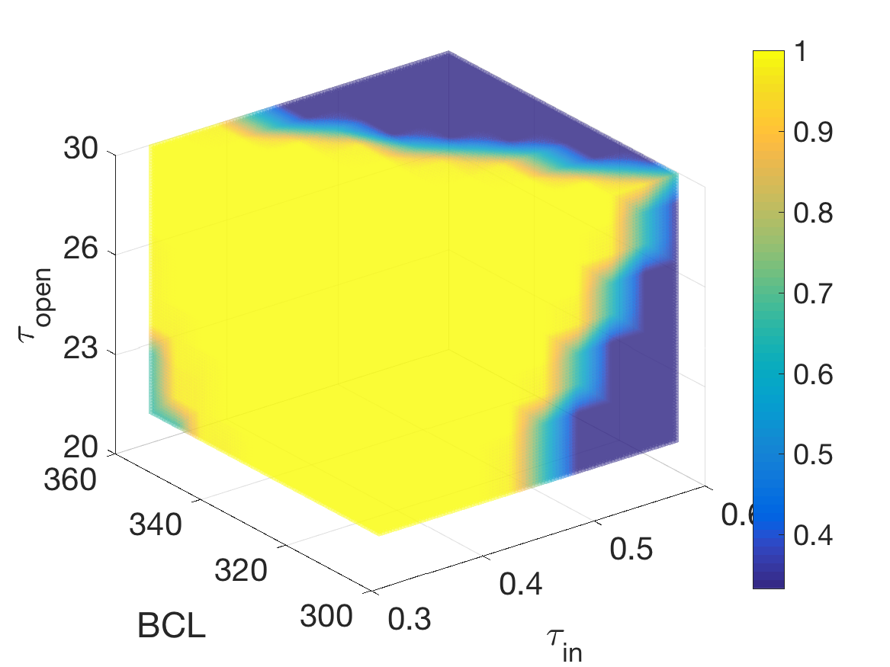
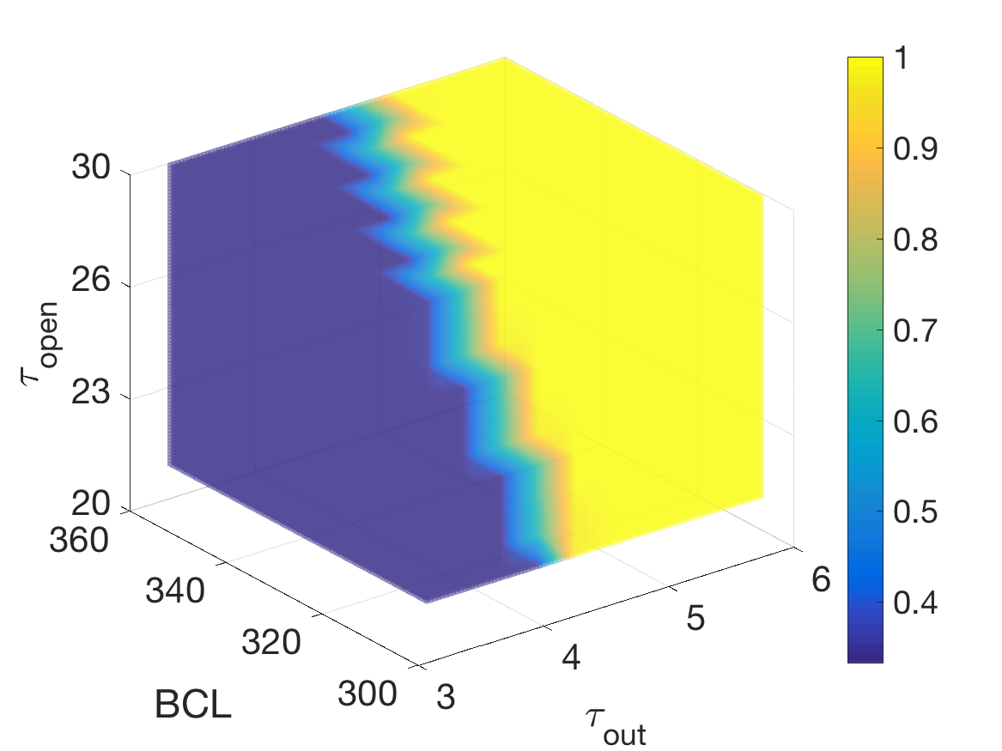
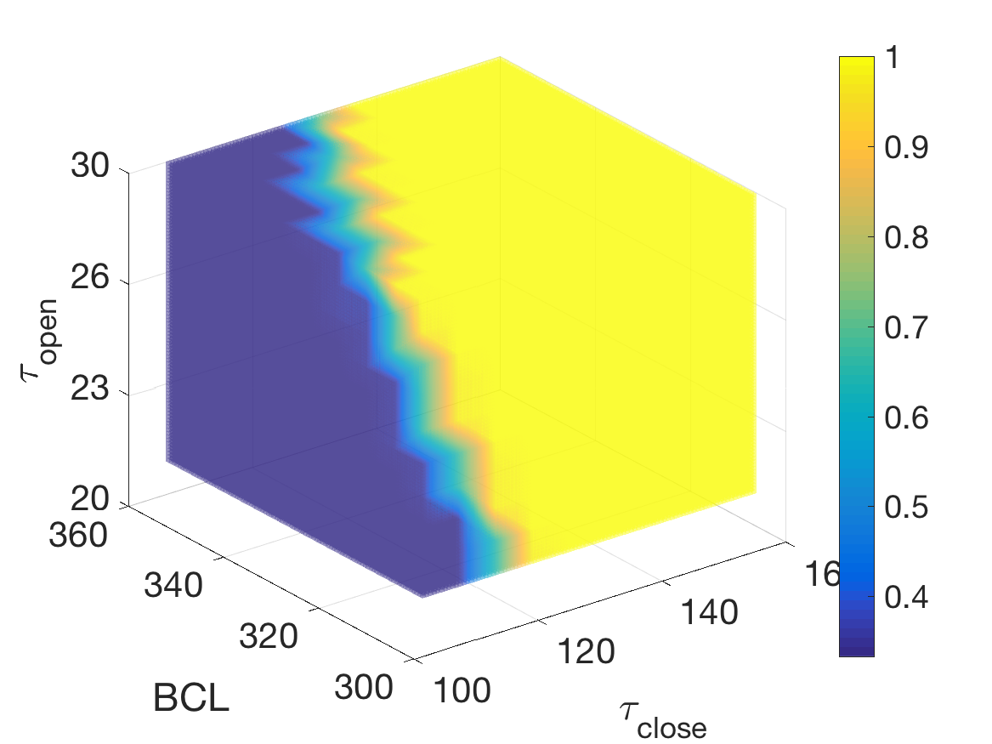
Three-Parameter Analysis

Slide 16
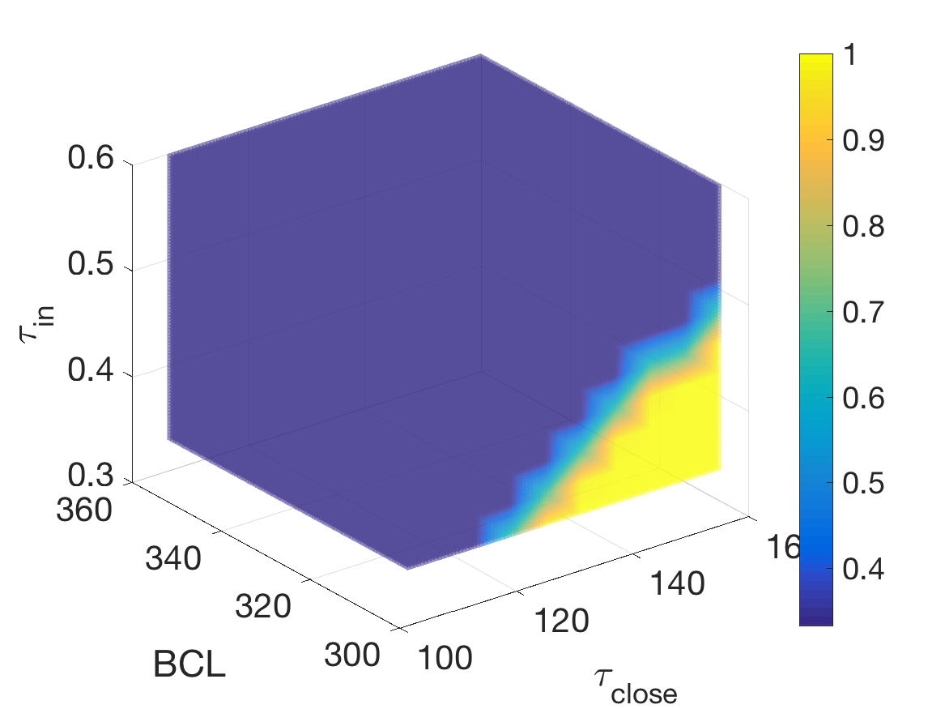
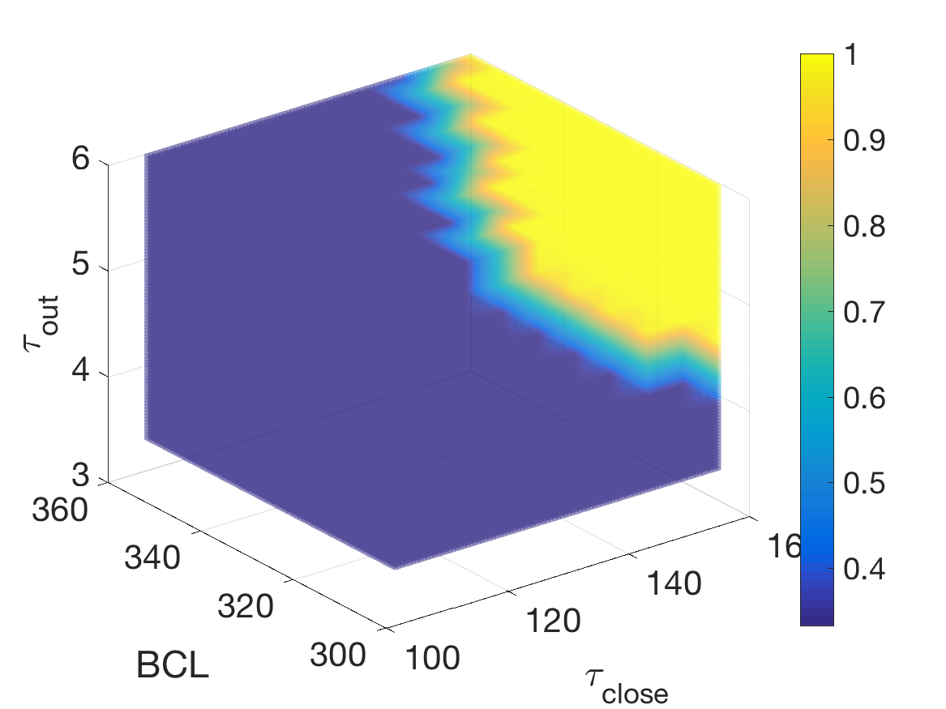
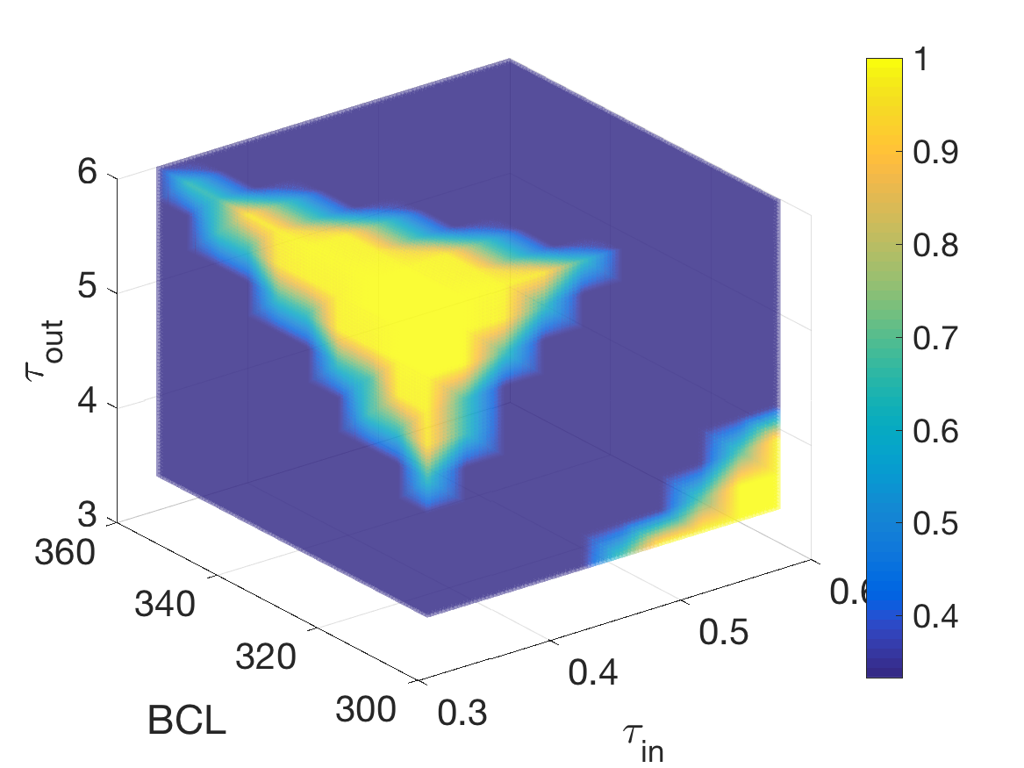
Three-Parameter Analysis

Slide 17
Conclusion: Summary and Future Work
Analyzing alternans based on the MS model
Formalize Alternans as a Hybrid Automaton
Bifurcation analysis of alternans for a subset of parameters of the MS model by reducing the problem to Probabilistic Reachability analysis
Partitioning parameter space into alternans and non-alternans regions
Analyzing Amplitude Alternans
Extend the analysis from cell level behavior to tissue level behavior: needs to extend reachability analysis on PDEs
Performing analysis on more than one variables simultaneously

